Slide 1
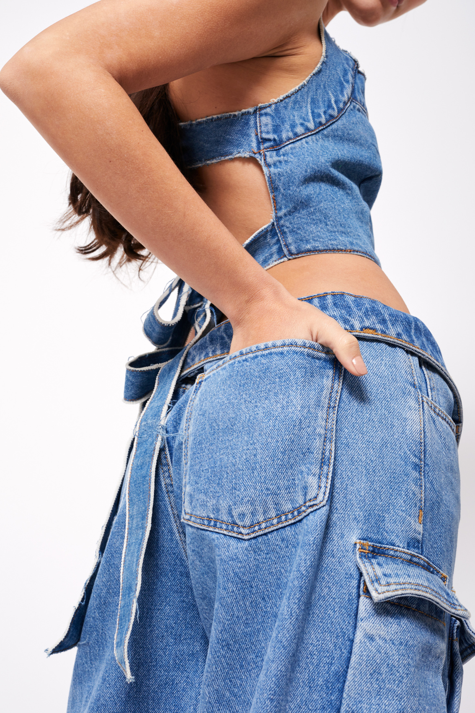

ARWEN’S APPAREL
SOCIAL MEDIA PLAN

Slide 2
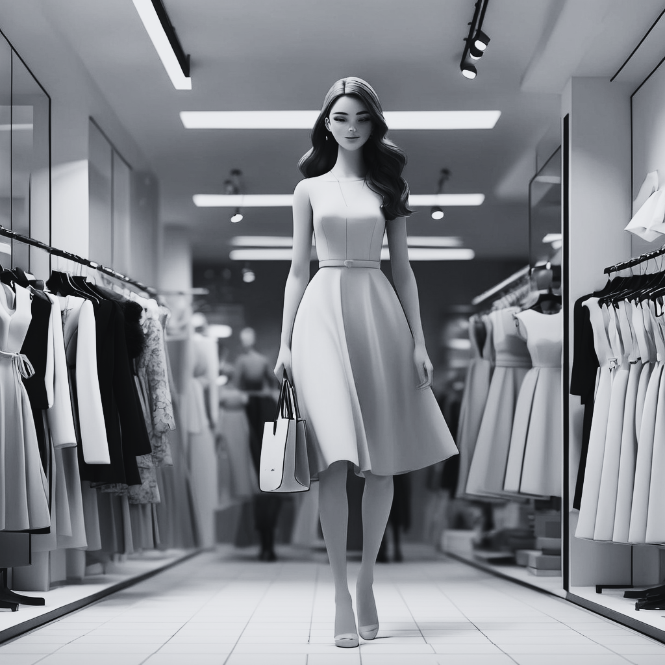
Company Overview
The Bamboo Clothing Store
  Arwen William in 2004, observed the growing interest in
eco-friendly option
  Drawing inspiration from Canada's rich tradition of high-quality manufacturing, she seized the opportunity to start an eco-friendly boutique called Arwen's Apparel
  Arwen's Apparel is a 95% locally made British Columbia brand
  With its garments crafted from bamboo trees, ensuring full sustainability
  Arwen’s Apparel expanded their offerings to include finely handcrafted jewelry at their studio in Downtown Kamloops, BC
  Customer comfort is their priority
Source- Arwen’s Apparel Facebook page, AI generated image

Slide 3

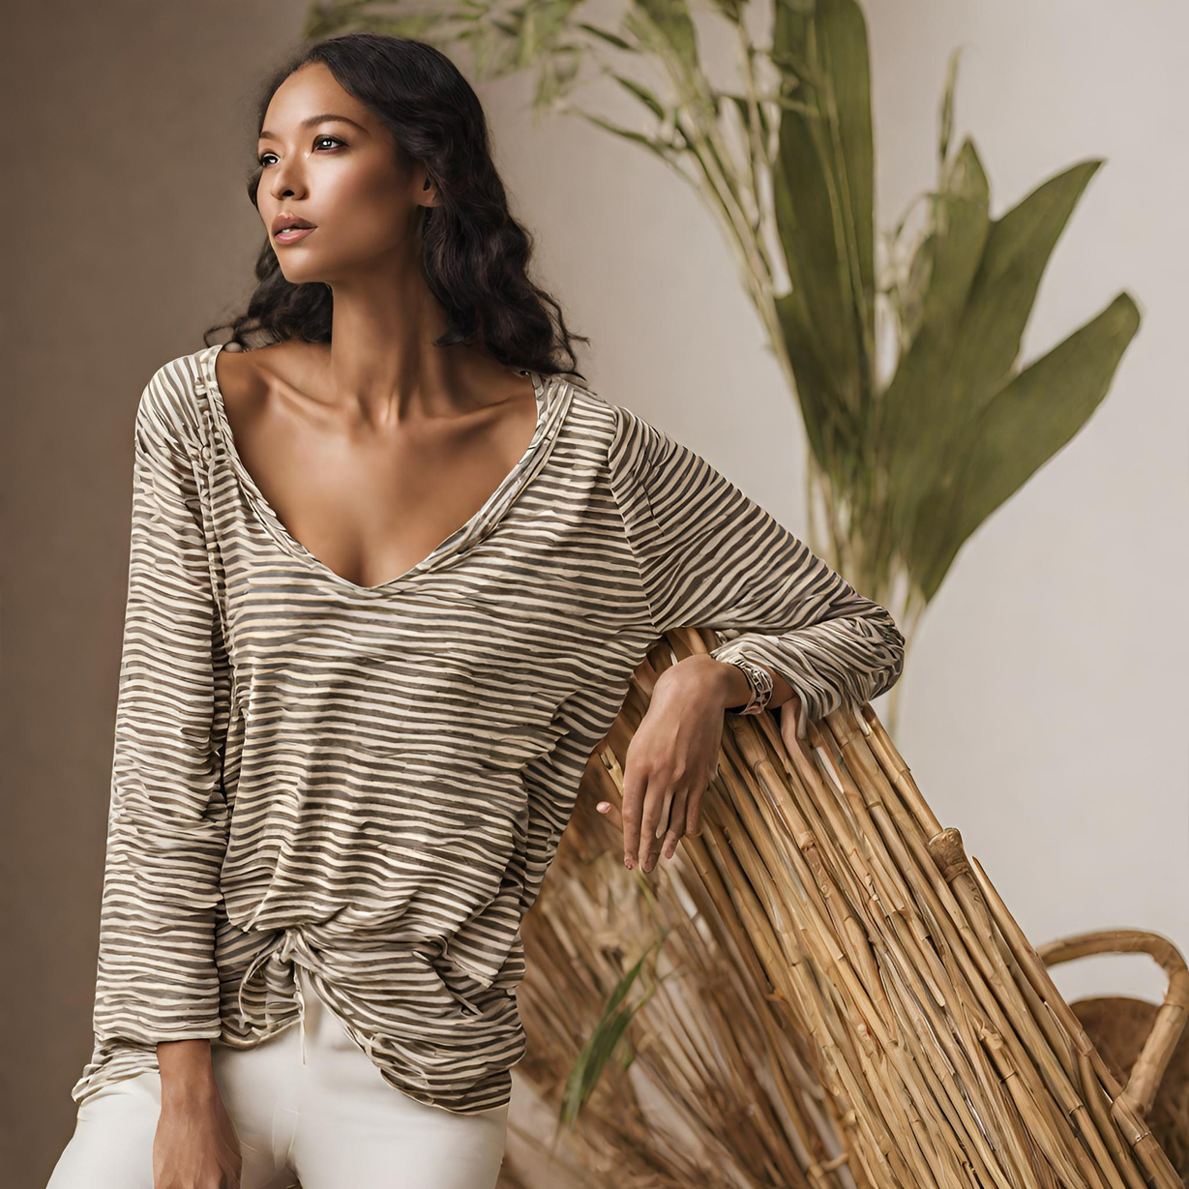
Analyzing the Industry
  Fashion Sector in Canada experienced growth before COVID-19, with a significant drop in 2020
  Recovered in 2022, reaching pre-pandemic sales levels
  Predicted retail market size of $34.3 billion in 2023, with 3.6% sector growth
  Fashion industry contributes 27% to Canada's e-Commerce market
  Expected to increase to nearly 34% by 2027
Source- Fashion and Apparel Industry Statistics in Canada. Report, AI generated image

Slide 4
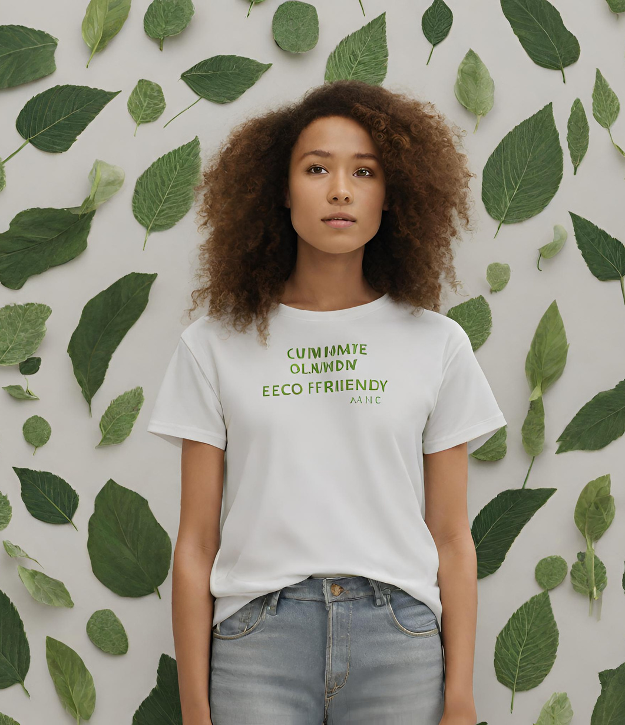
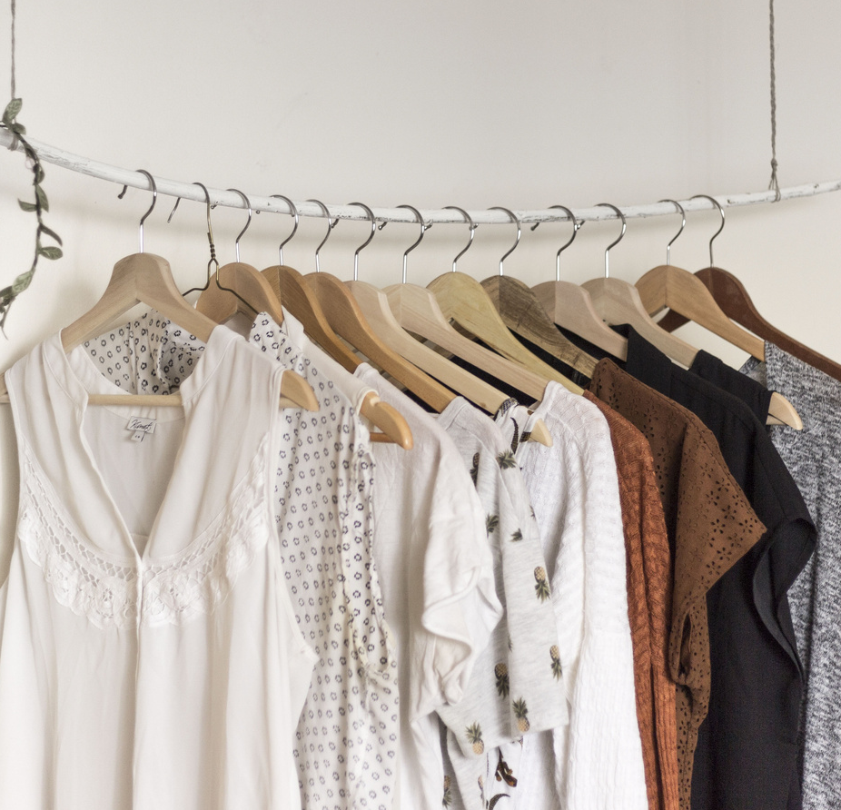

Demand for Sustainable Goods:
  Growing trend driven by consumer demand for environmentally friendly products
  33% of Canadians willing to pay more for sustainable goods
Sustainable Fashion and Bamboo Clothing:
  Bamboo clothing symbolizes elegance and grace in design.
  Versatile fabric used for stylish and innovative pieces
  Popular styles include vibrant designs, patterns, draping, and asymmetrical cuts
Analyzing the category
Source- Sustainable Retail Revolution: Strategies for Eco-Friendly Transportation and Shipping Practices, AI generated image

Slide 5
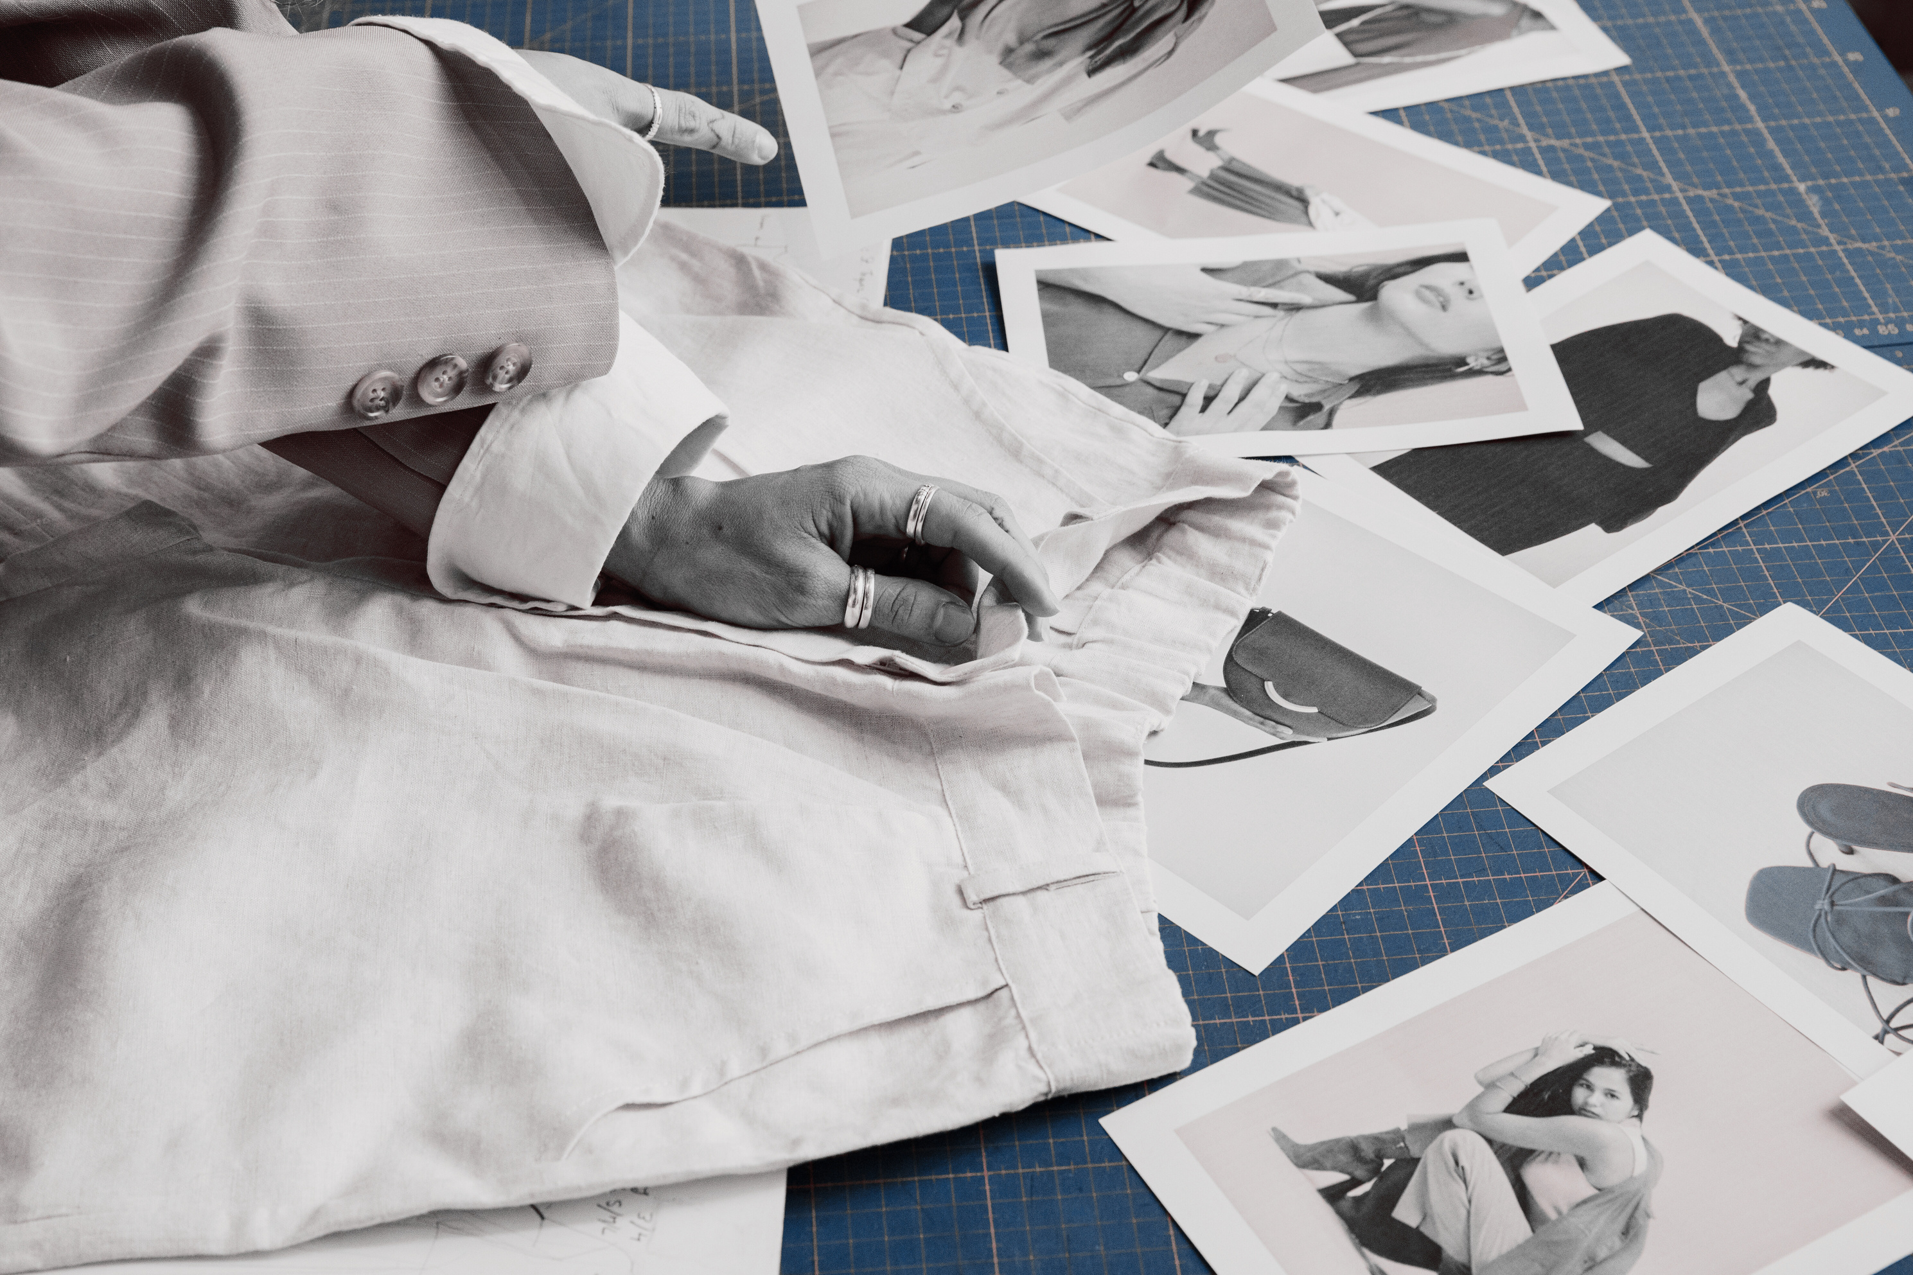

Understanding Our Competition

Slide 6
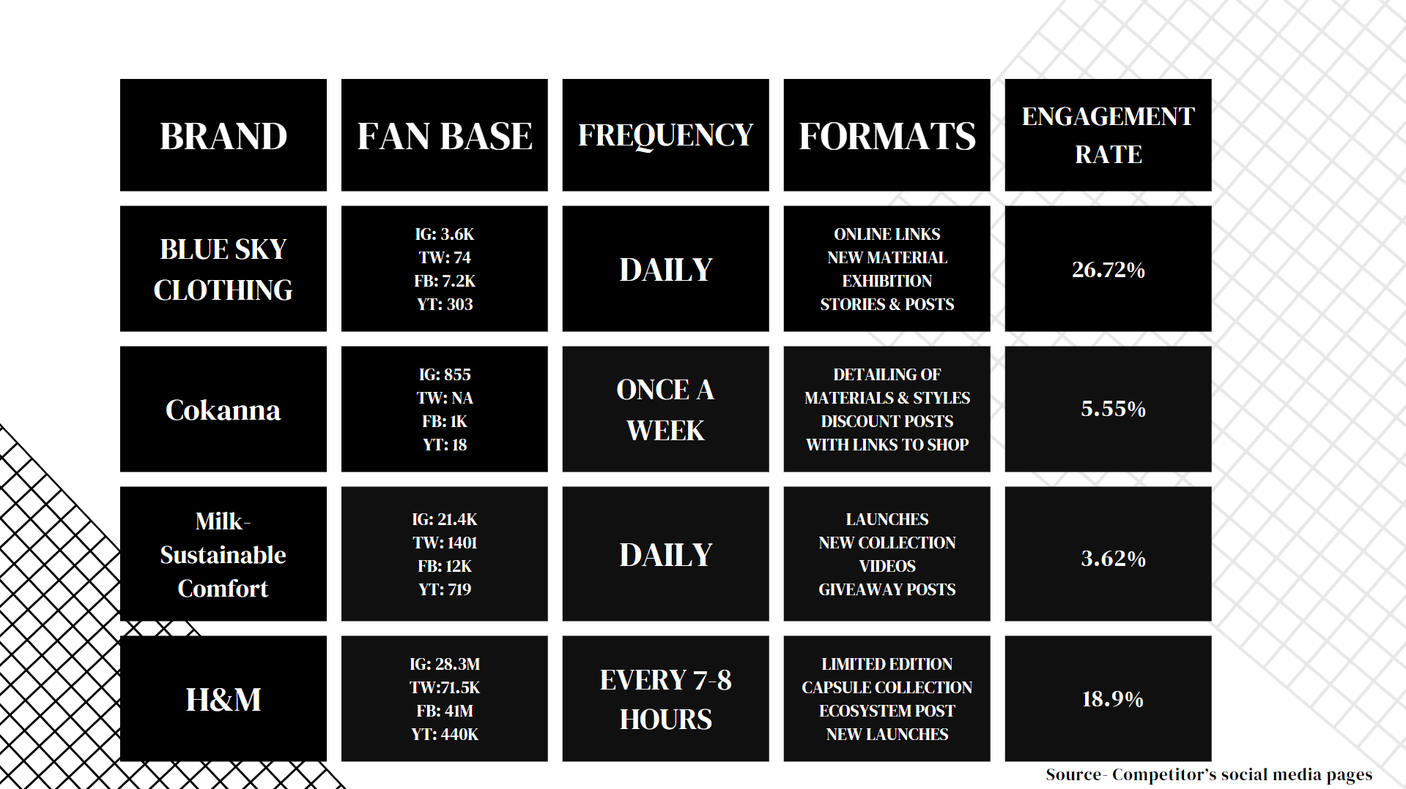
5.55%
3.62%
18.9%
Source- Competitor’s social media pages

Slide 7
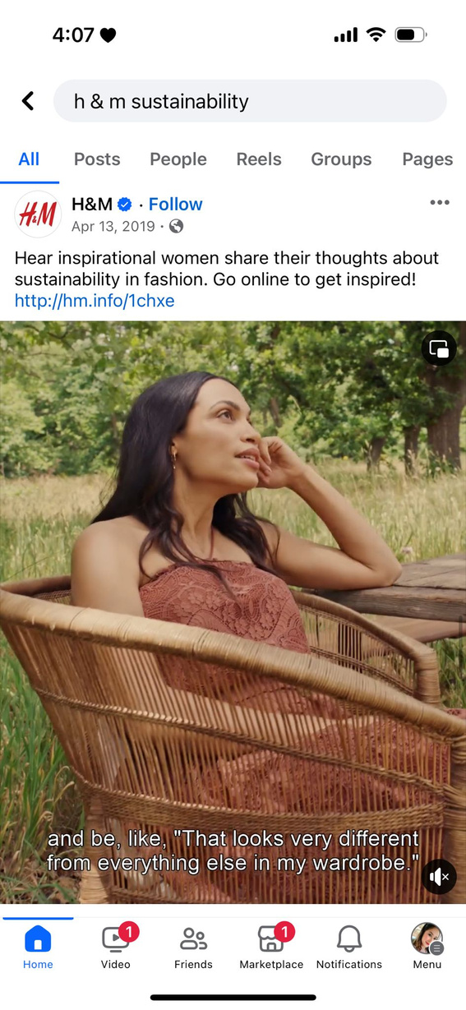
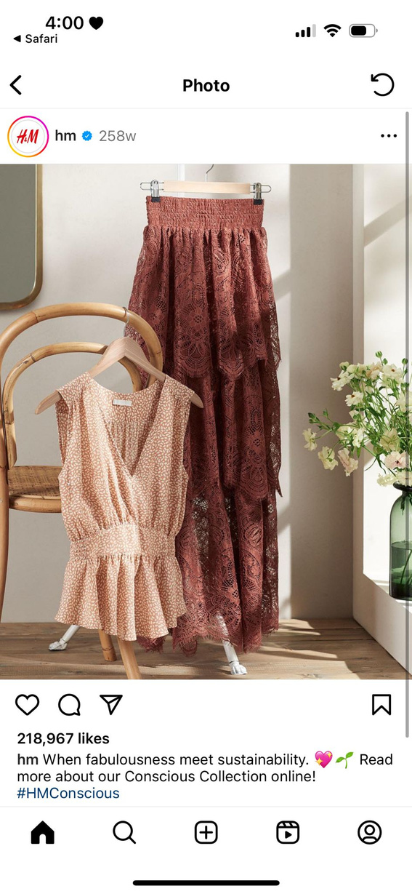
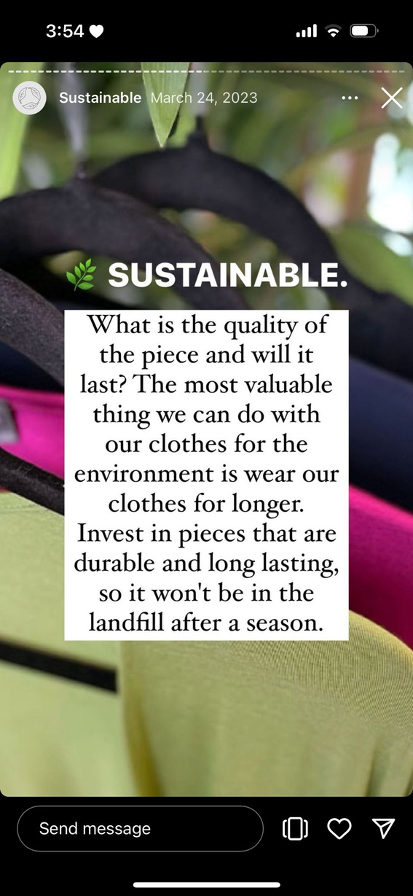
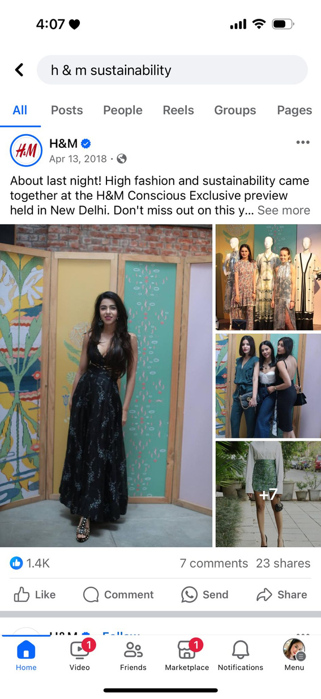
What our competition looks on social
Source- Competitor’s social media pages

Slide 8
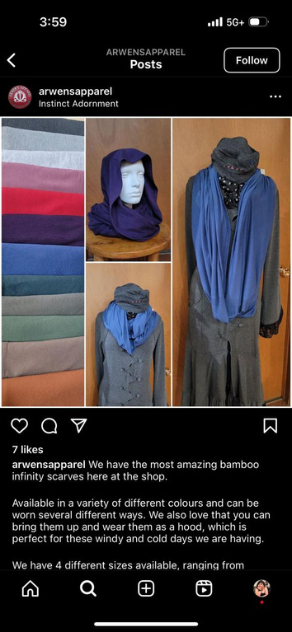
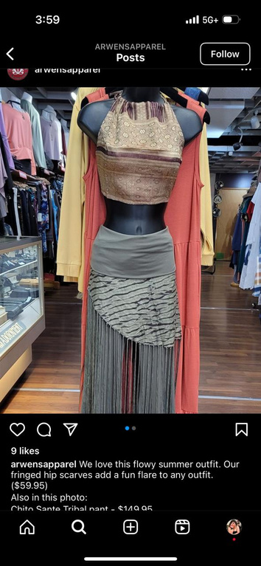
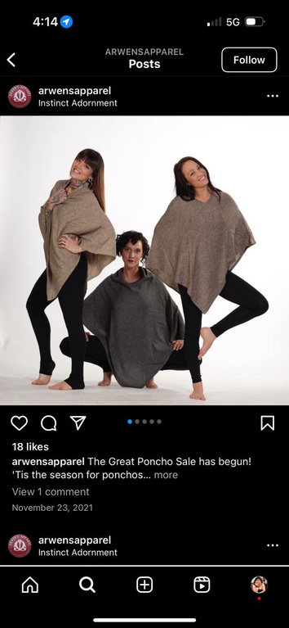
FACEBOOK:
  Followers: 1.3K
  Engagement Rate: 1.92%
  Profile URL: https://www.facebook.com/ArwensApparel/
Our Current Social Media Analysis
INSTAGRAM:
  Followers: 358
  Engagement Rate: 3.35%
  Profile URL: https://www.instagram.com/arwensapparel/
TWITTER:
  Followed by: 21 people
  Engagement Rate: 9.52%
  Profile URL: https://twitter.com/arwensapparel/
Source-Arwen’s Apparel social media pages

Slide 9


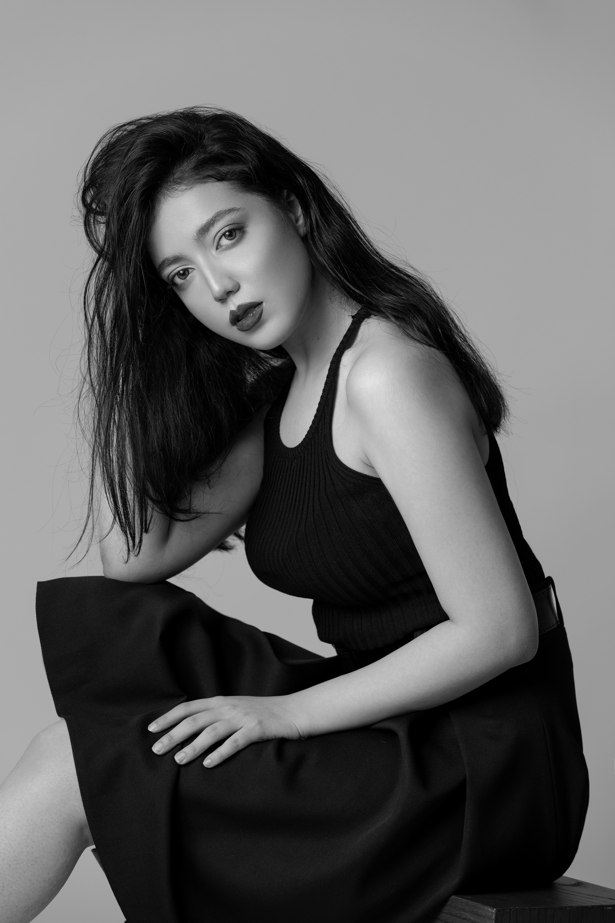
SWOT
STRENGTHS:
  Sustainability Commitment: Leader in eco-friendly fashion with bamboo fabric
  Local Manufacturing: 95% local production in British Columbia
  High-quality Products: Durable bamboo fabric clothing
  Unique Selling Proposition: Blend of durability and sustainability
  Innovation: Expanding product lines and materials
WEAKNESSES:
  Limited Variety: Focus on bamboo fabric limits product range
  Dependency on Local Suppliers: Vulnerable supply chain during disruptions
  Competition: Challenged by established sustainable brands
  Pricing Sensitivity: Higher costs from eco-friendly materials
  Brand Awareness: Struggle against larger competitors
Source- AI generated image

Slide 10
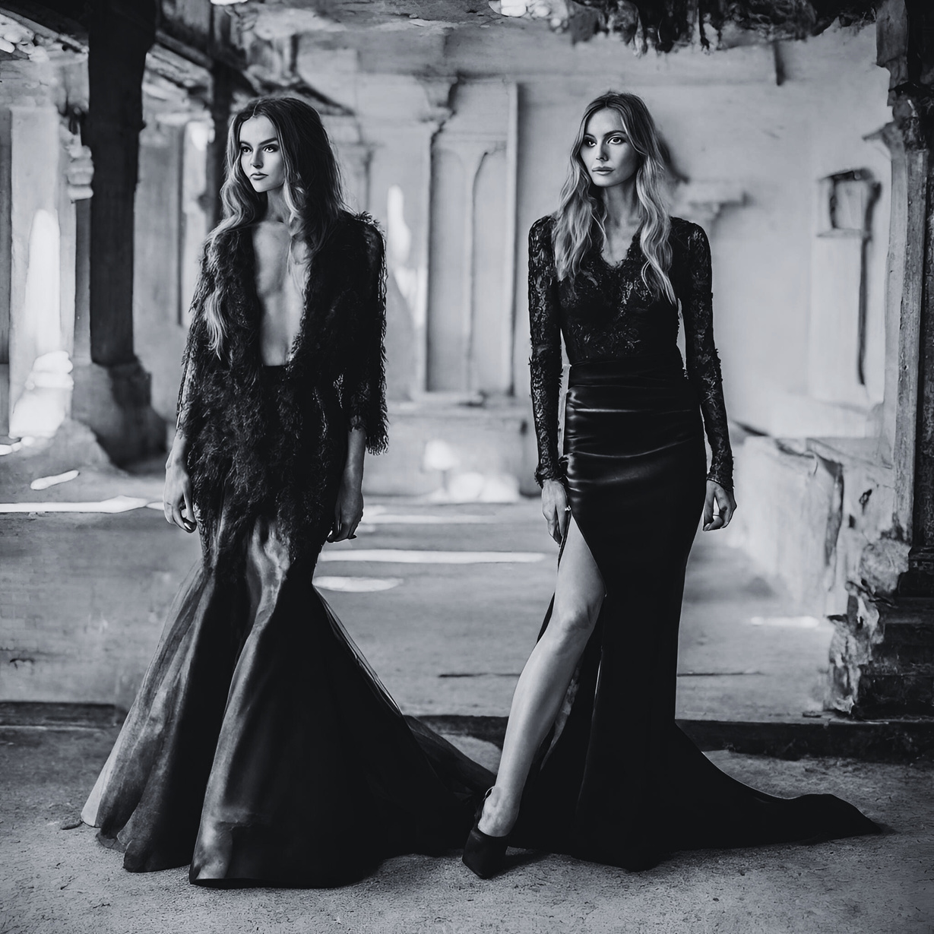
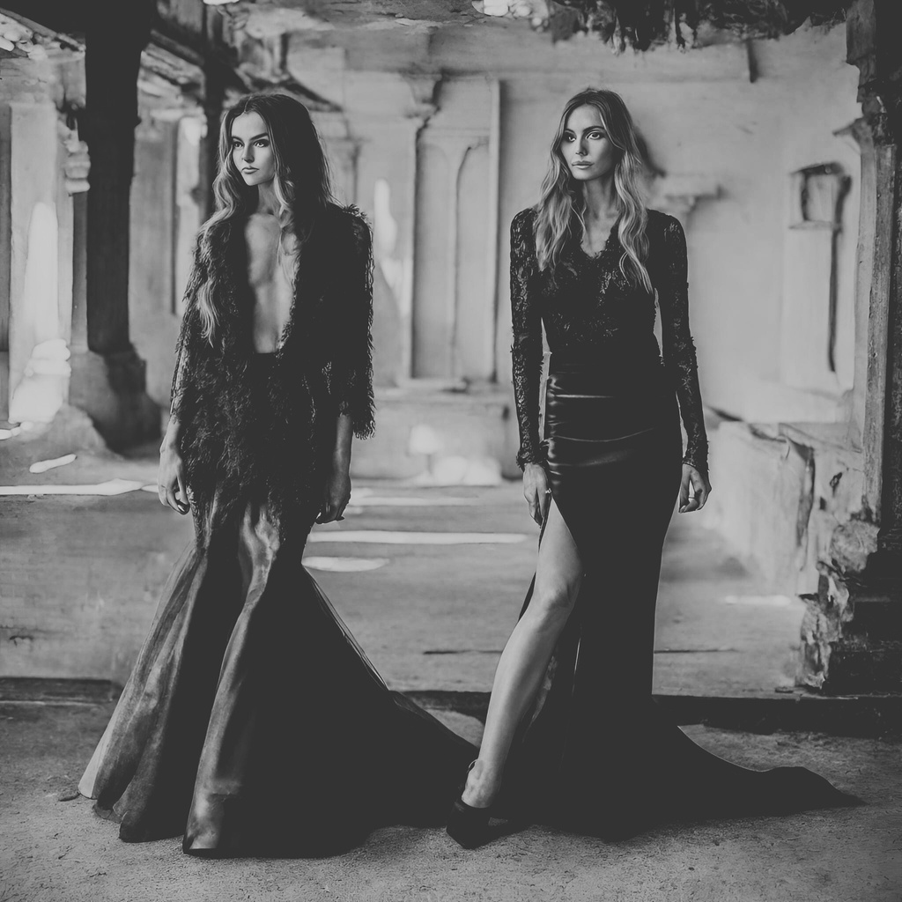
SWOT
OPPORTUNITIES:
  Growing Eco-demand: Rising preference for sustainable fashion
  Online Expansion: Tapping into the growing online market.
  Social Media Engagement: Leveraging platforms for brand visibility
  Unique Positioning: Capitalizing on sustainability and durability
  Global Reach: Expansion into new markets.
THREATS:
  Increased Competition: Growing rivalry within sustainable fashion
  Economic Volatility: Impact on consumer spending habits.
  Supply Chain Risks: Disruptions in production and sourcing
  Changing Trends: Failure to adapt to shifting consumer preferences
  Fast Fashion Pressure: Competition from cheaper alternatives
Source- AI generated image

Slide 11

REDUCE YOUR
IMPACT
BY SUPPORTING LOCAL BRANDS
Source- AI generated image

Slide 12
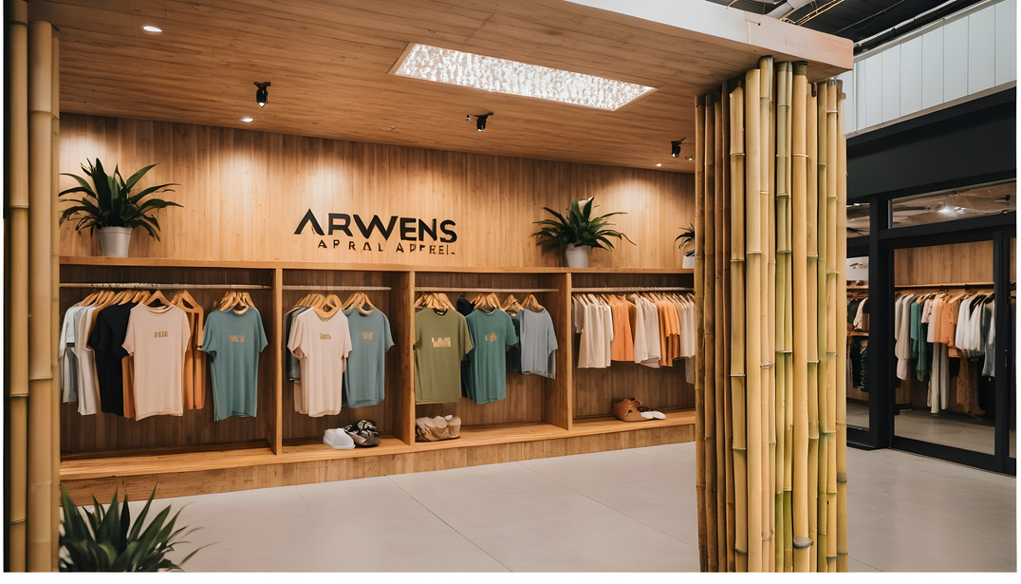
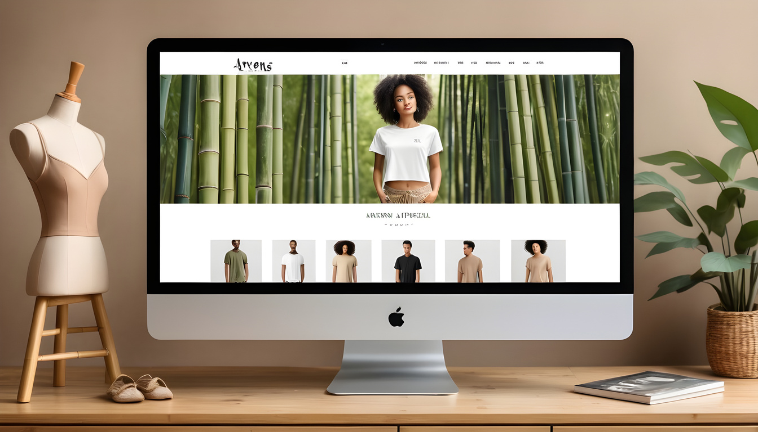
Goals
Create brand awareness and foster greater engagement among Arwen’s apparel followers on Instagram, Facebook, and Pinterest
To attract potential new customers to our social media pages with the ultimate goal of directing traffic to Arwen’s social website
Source- AI generated image

Slide 13

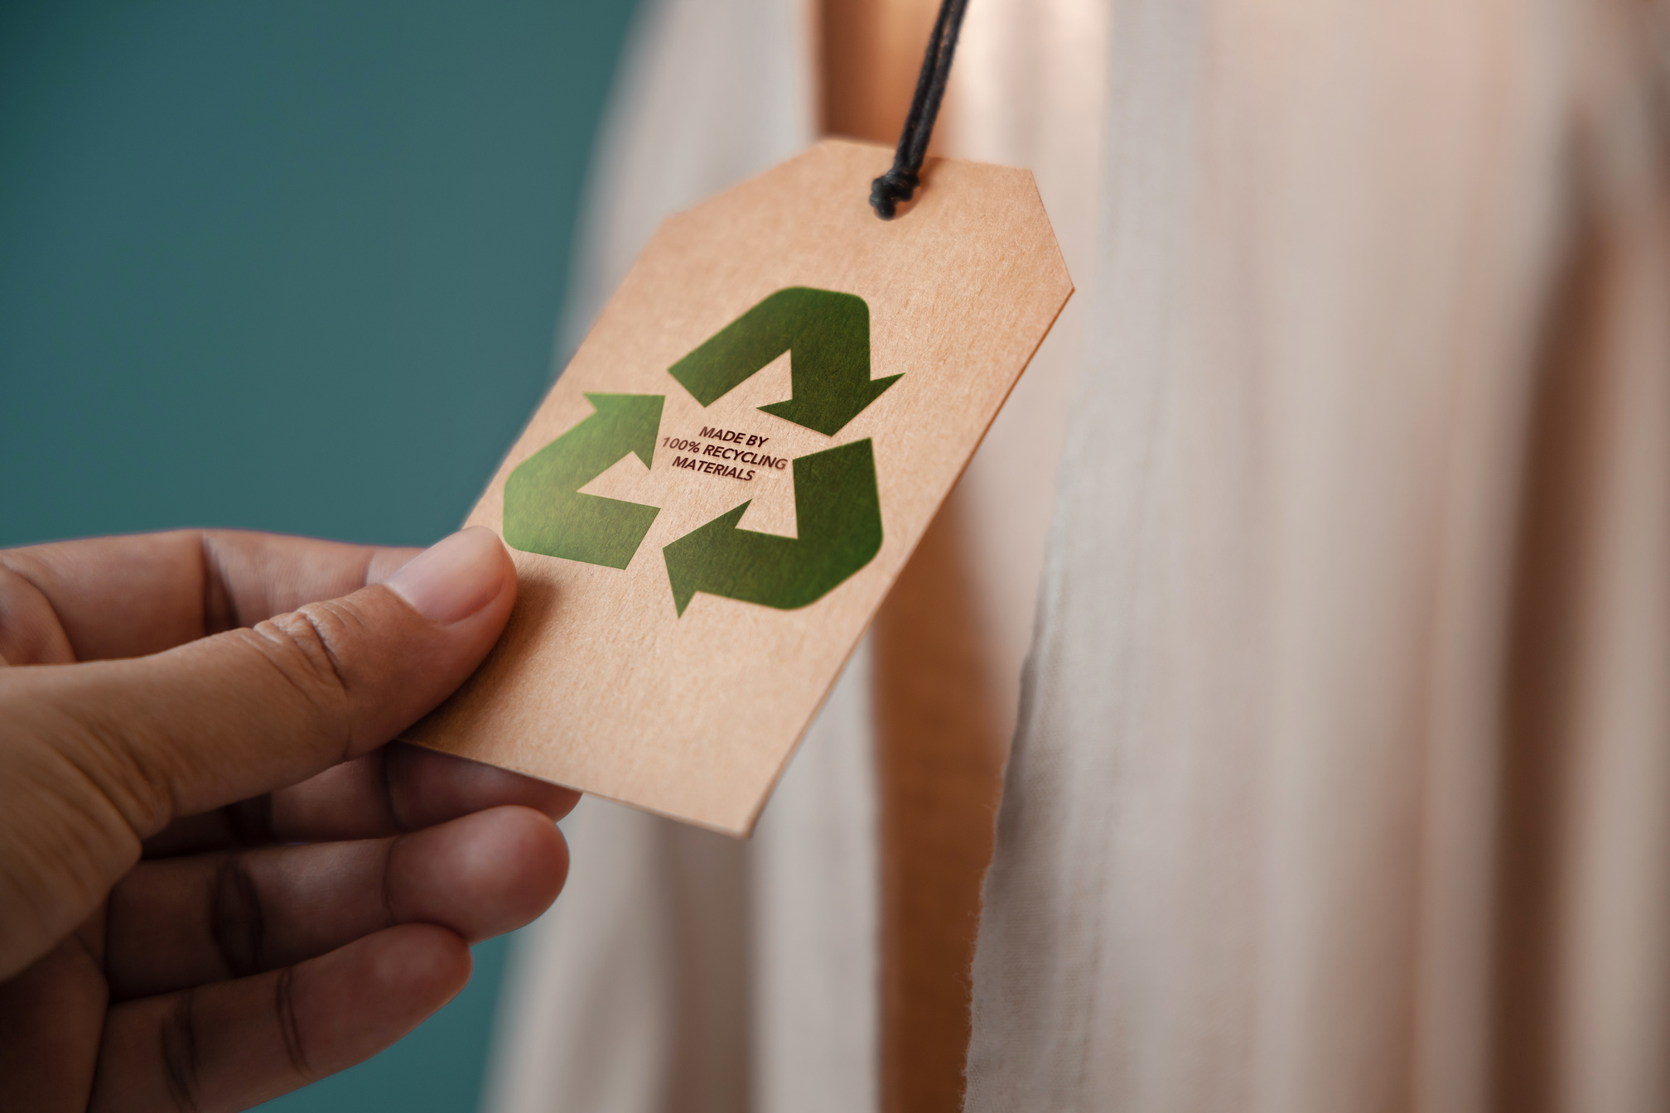
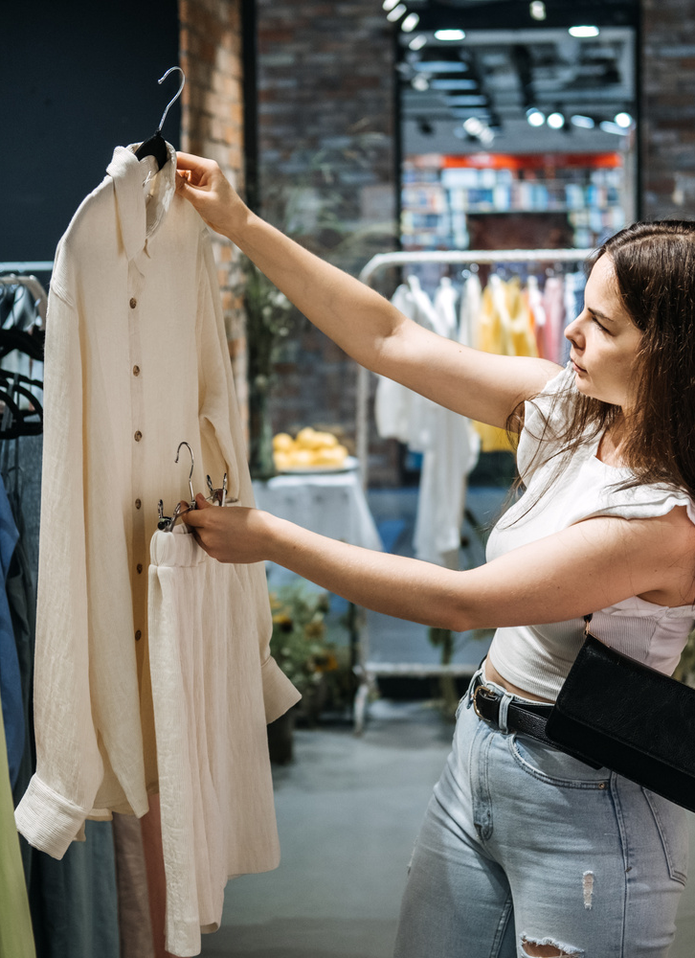
01
Increase awareness and discussion about
Arwen's clothing by 20% in the next 6 months
02
Objectives
Drive a 10% increase in sales
within the next 12 months
Source- AI generated image

Slide 14
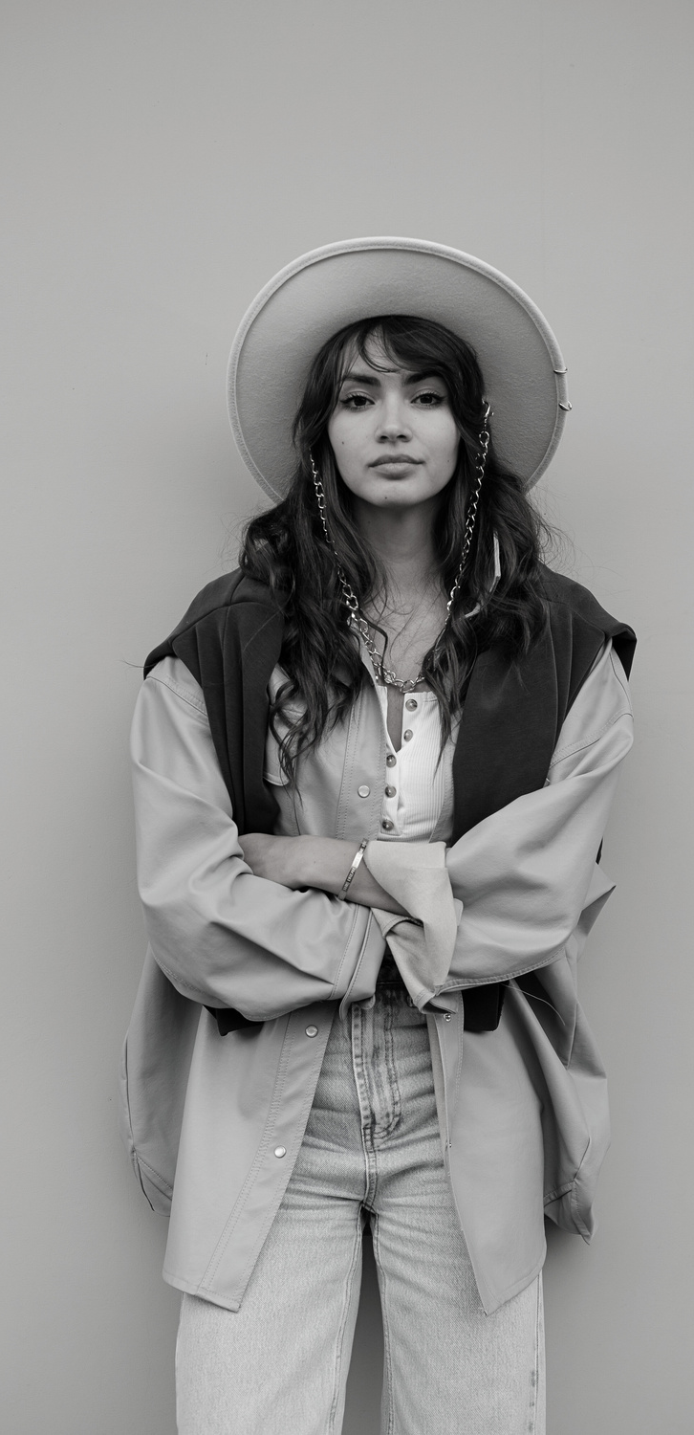
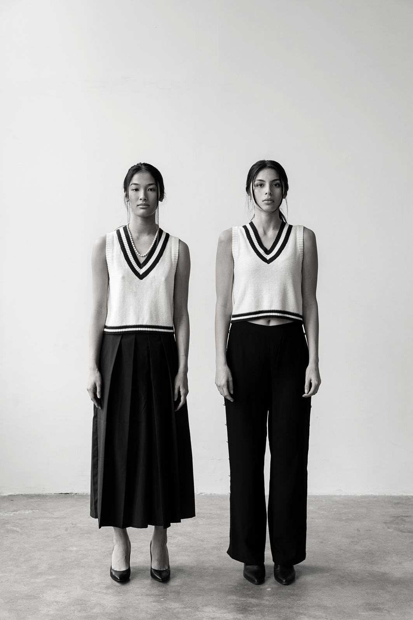
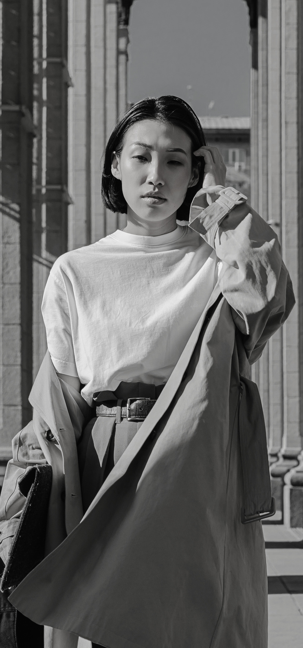

WHERE SUSTAINABILITY MEETS DURABILITY
USP
Source- AI generated image

Slide 15
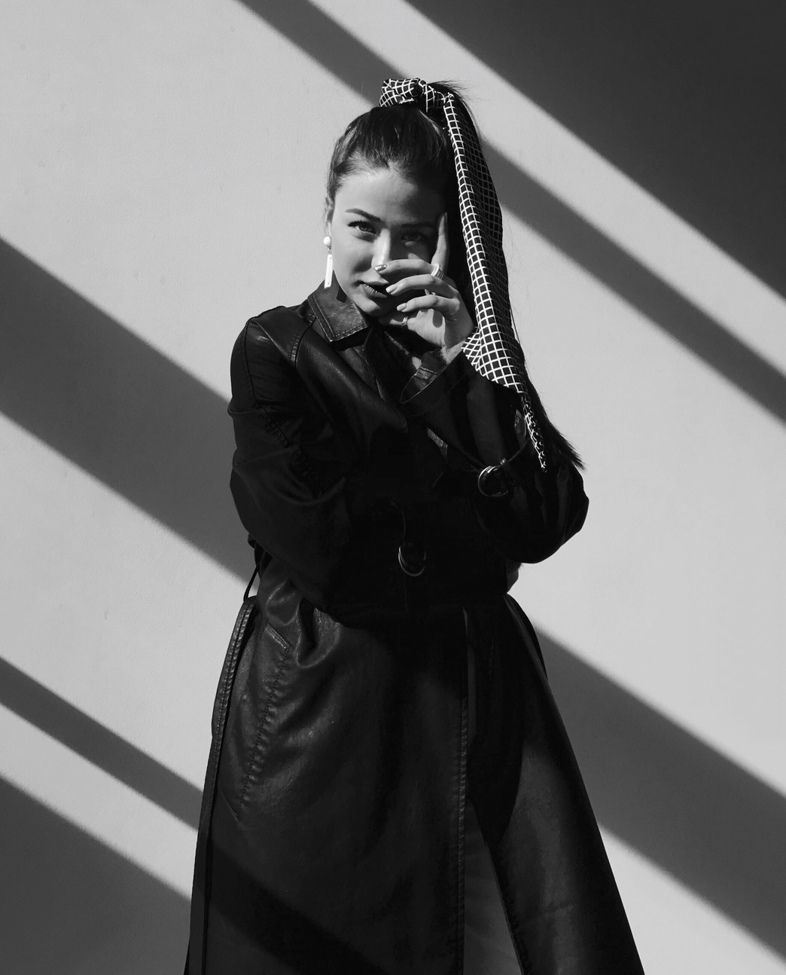
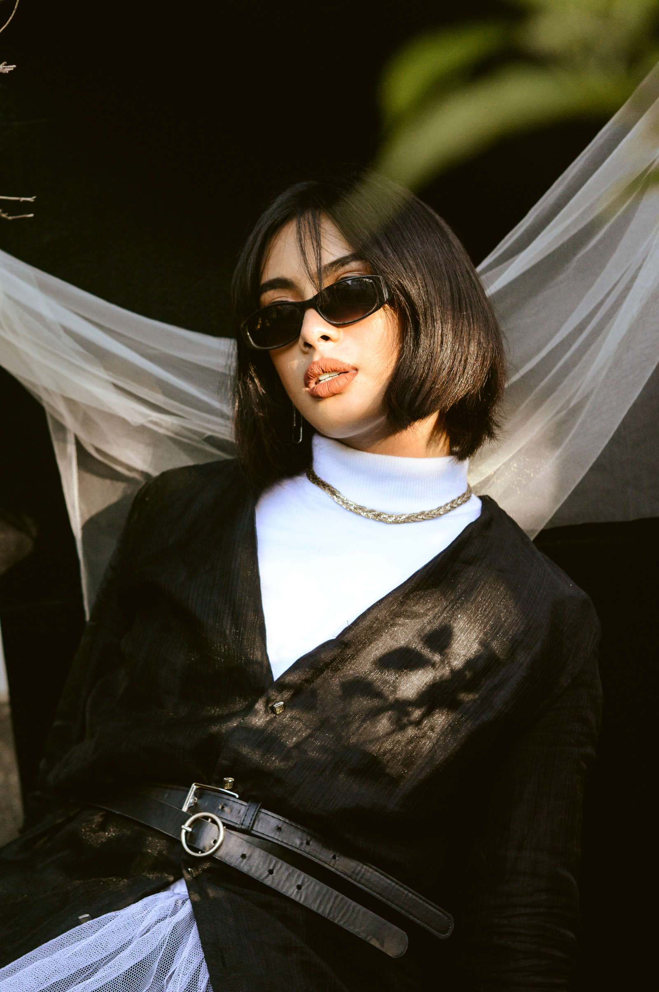
AUDIENCE

Slide 16

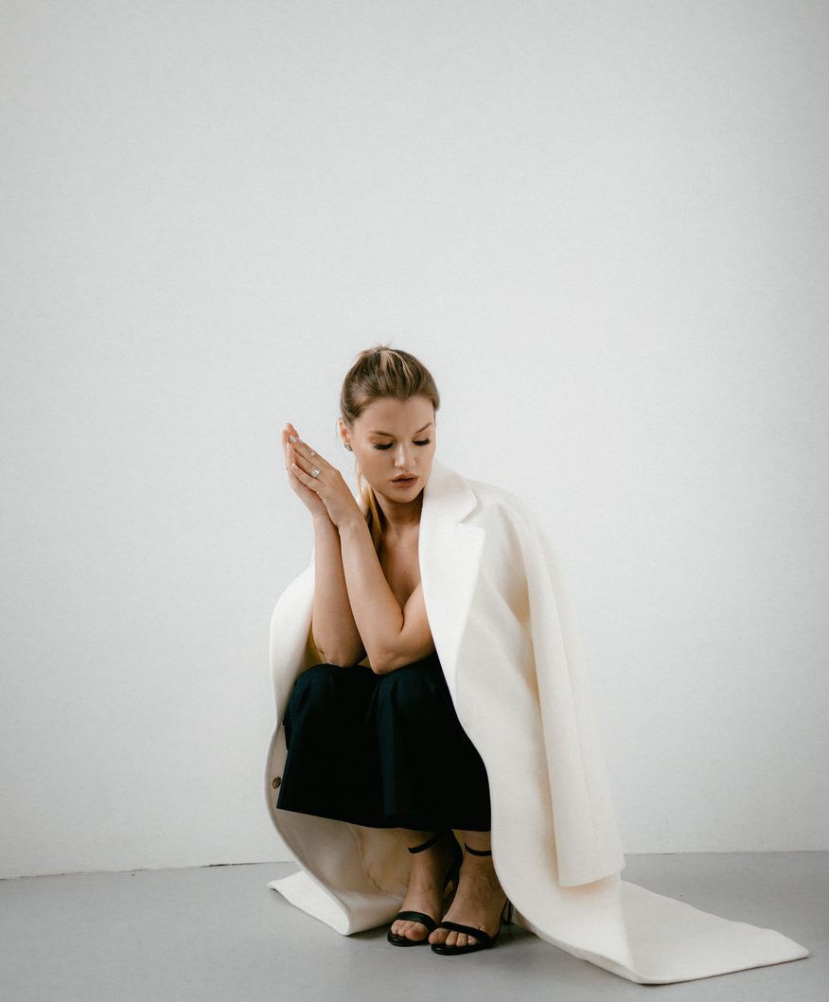
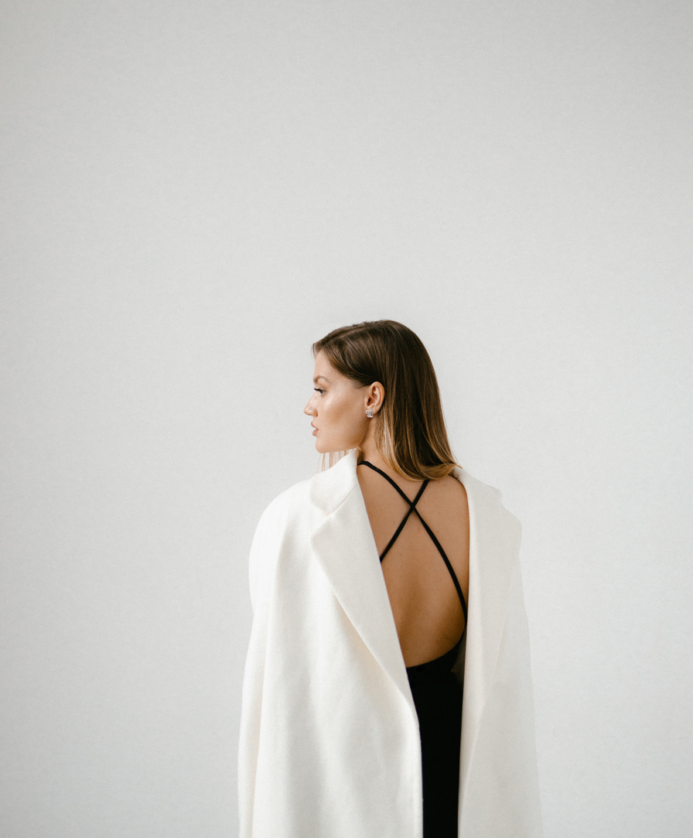
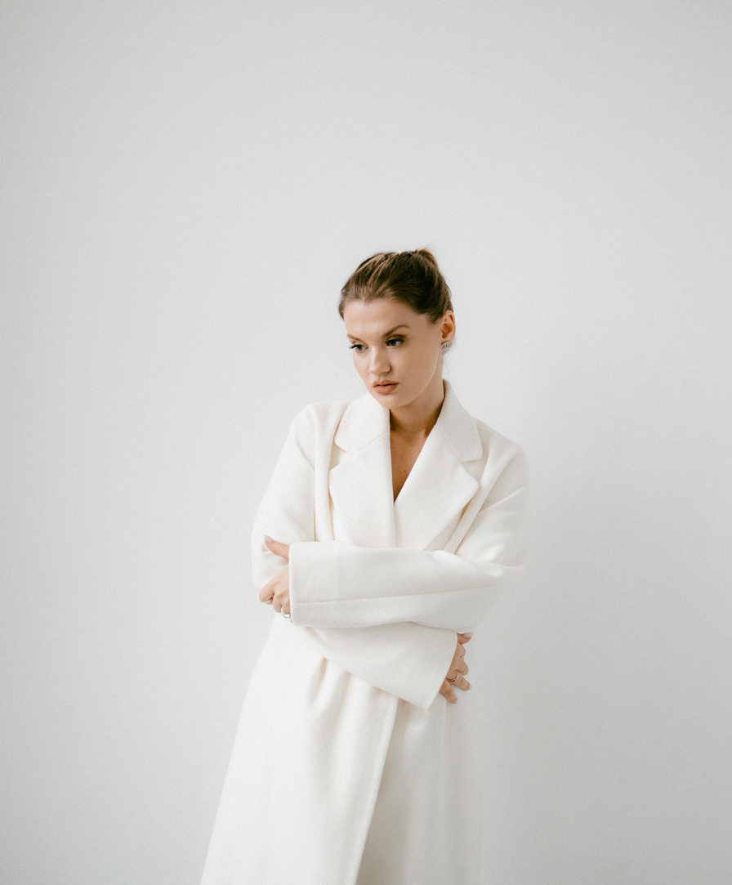
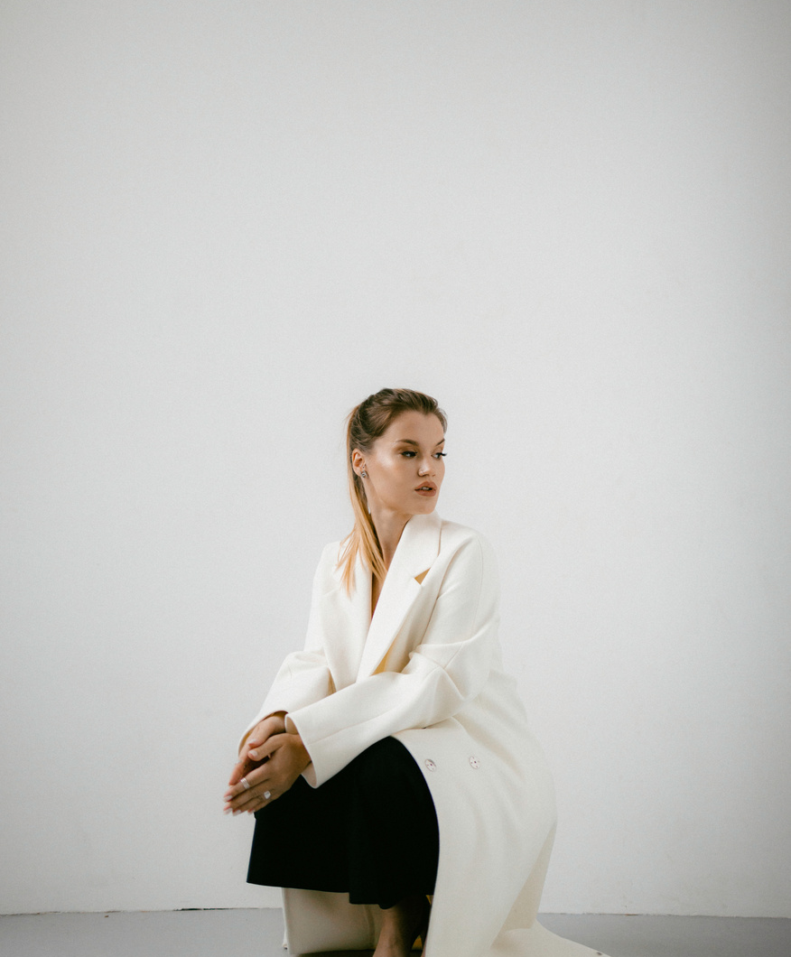
25-40 year female and their online usage
The 25-40 age group is the most active in online shopping
Women are slightly more active on social media than men, particularly in the 25-40 age group
25-40 age group being the largest demographic of social media users
25-40 age group care about sustainability more than anyone else and search about it online too
Source: Fashion and Apparel Industry Statistics in Canada. Made in CA Report

Slide 17
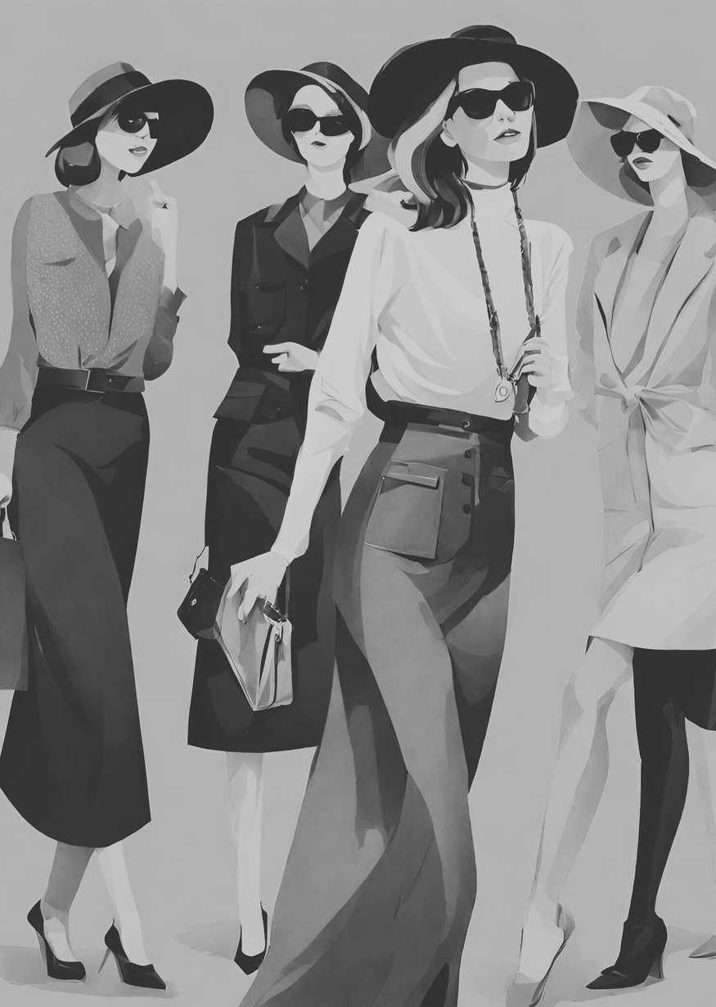
Target Audience
Women aged 25-40, residing in and
near British Columbia
Demographic
Moderate to high disposable income
Demographic
From diverse occupations, ranging from corporate professionals to freelancers and entrepreneurs
Demographic
Concerned about environmental impact
Demographic
Seek high-quality, durable products at affordable prices
Psychographic
Actively use social media, especially Instagram and Facebook
Psychographic
Appreciate authenticity and transparency, rely on research
Psychographic
Source- AI generated image

Slide 18

ECO-CONSCIOUS ELISHA
Buyer
Persona

Slide 19
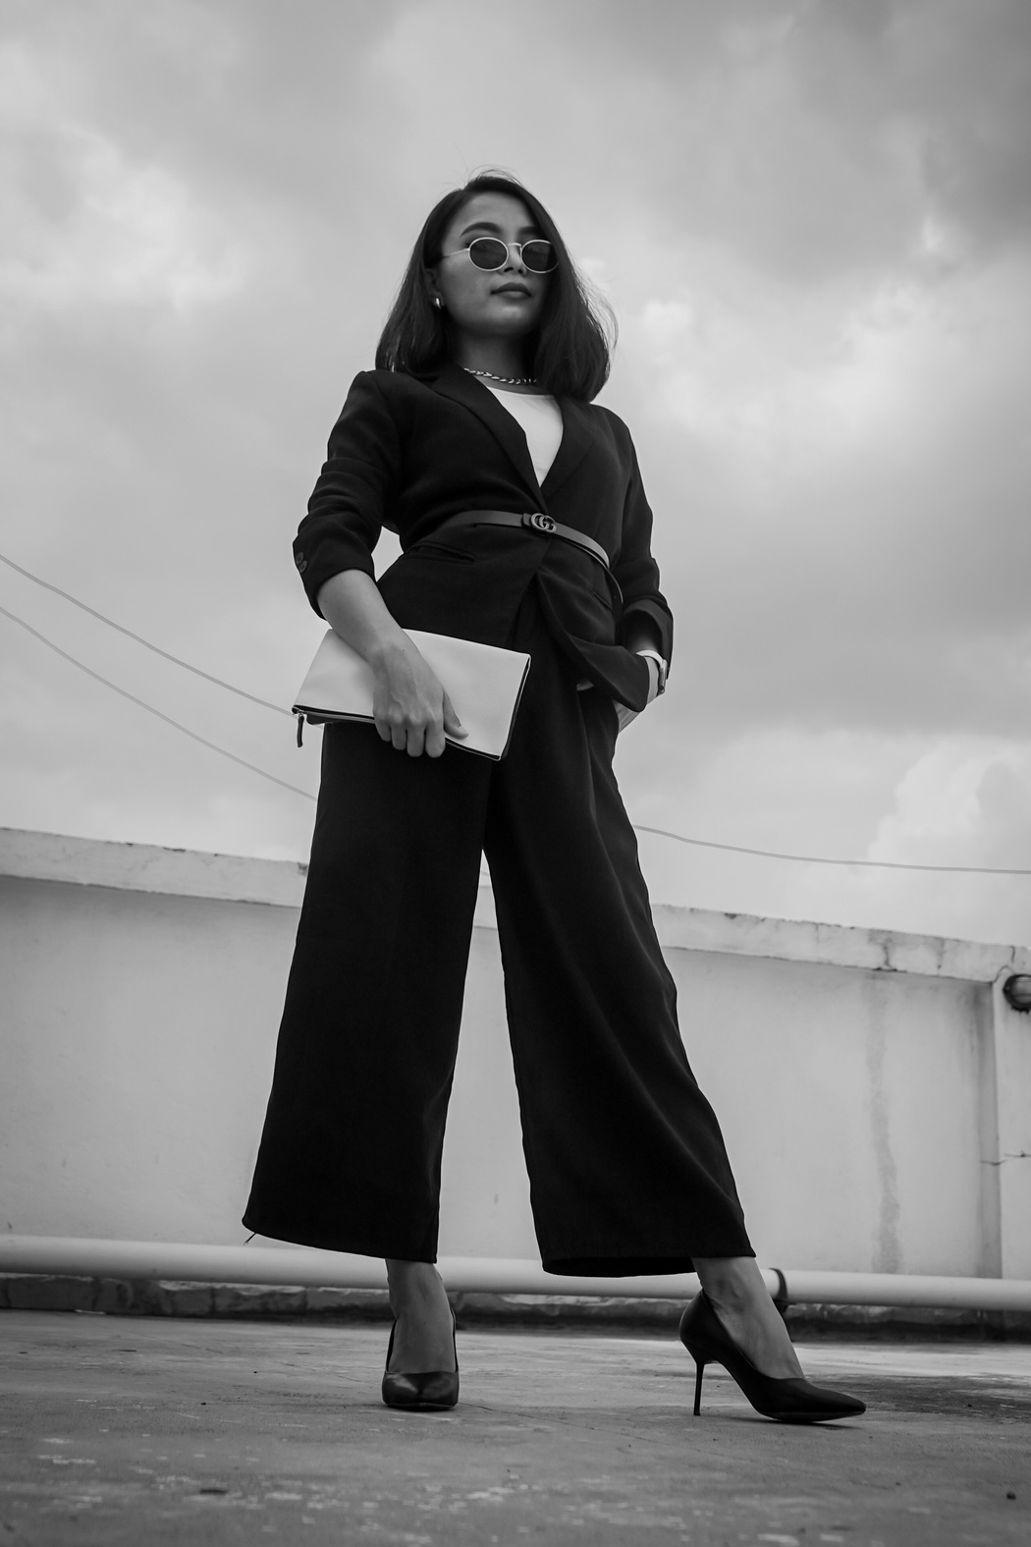

PSYCHOGRAPHICS
Values and Beliefs: Prioritizes environmental consciousness, seeks eco-friendly and cruelty-free products.
Lifestyle: Leads a busy lifestyle, values convenience, relies on packed vegan meals.
Interests: Interested in fashion, enjoys versatile and affordable clothing options.
Behaviors: Active on Instagram and Pinterest, follows eco-friendly fashion influencers.
DEMOGRAPHICS
Name: Elisha Walter
Age: 27 years old
Location: Kamloops
Income Level: Earns 19 CAD per hour, works 40 hours a week
Occupation: Food Safety Delivery Manager at Fresh Street Market
Marital Status: Married with a two-year-old baby girl
Source- AI generated image

Slide 20
GOALS
Career: Aims to work as a food safety officer in a multinational corporation.
Family: Wants to send her daughter to the best school in Kamloops and educate her about sustainable living.
Personal: Aims to incorporate sustainable practices into her daily life and build an eco-friendly wardrobe.
PREFERRED COMMUNICATION CHANNELS
Online Engagement: Prefers buying from local stores online.
Social Media: Engages with brands and discovers new products on Instagram.
BUYING PREFERENCES
Investment: Willing to invest in high-quality, ethically made clothing.
Affordability: Seeks affordable prices due to frequent fashion updates.
Transparency: Values transparent and ethical brands prioritizing sustainability and social responsibility.
Source- AI generated image

Slide 21

A DAY IN THE LIFE OF ELISHA
Source- AI generated image

Slide 22

https://youtu.be/PGk2fKMUGnU?si=OhQ2fGT-i5eqzc2p
Source- AI generated video

Slide 23
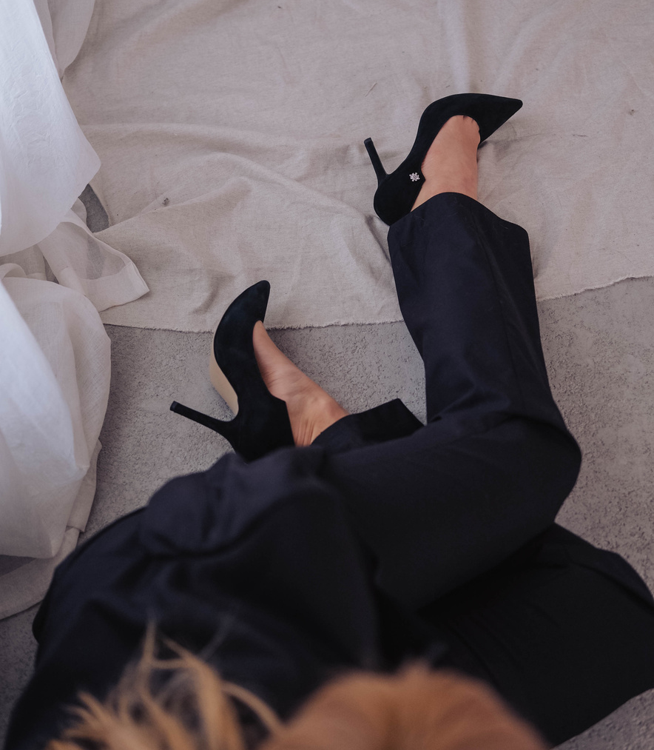
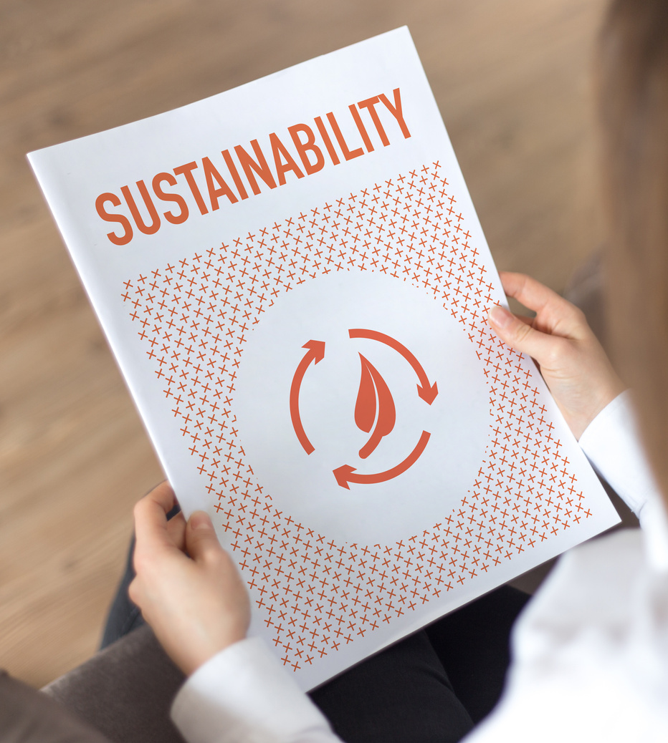

Our Approach
EDUCATE, ENGAGE, INFLUENCE
Source- AI generated image

Slide 24

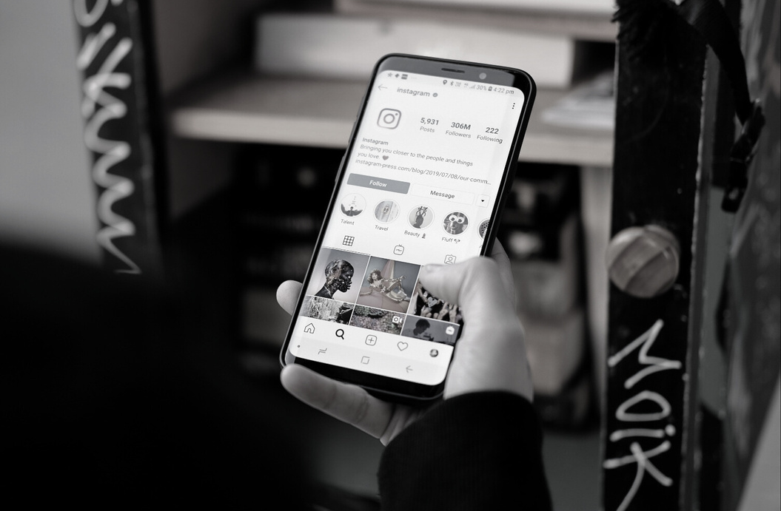
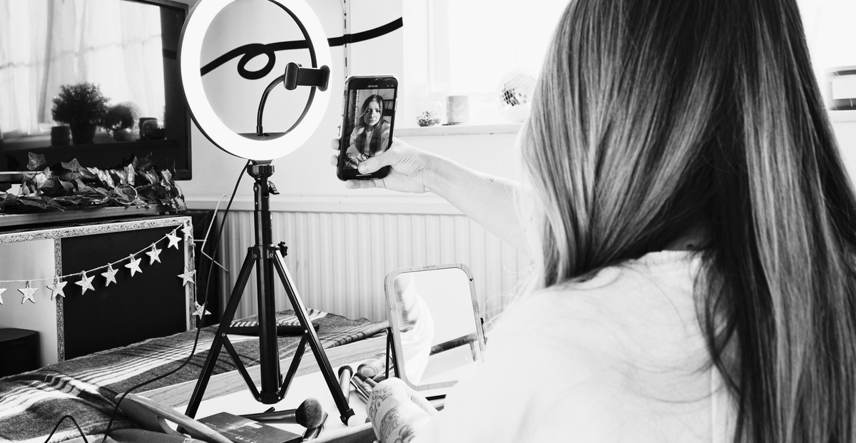
Instagram
Tik-Tok
Facebook
LinkedIn
Twitter
Pinterest
WordPress
Platforms to be used
Source- AI generated image

Slide 25

Tools to be used
GOALS
  Hubspot
  Google Analytics
  Instagram/Facebook built-in analytics tool
  WordPress built in analytics
  Facebook Ad Manger
Source- AI generated image

Slide 26




KPI’s
Engagement Rates: Likes, comments, shares, reshares ,views and saves
Tracking follower growth rate
Track website traffic and conversion rates
Source- AI generated image

Slide 27







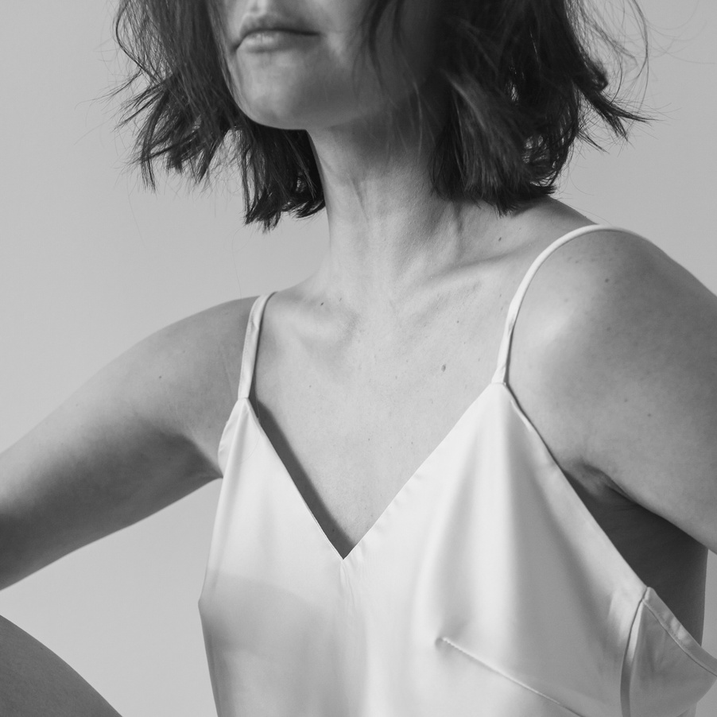
CONTENT IS THE QUEEN

Slide 28
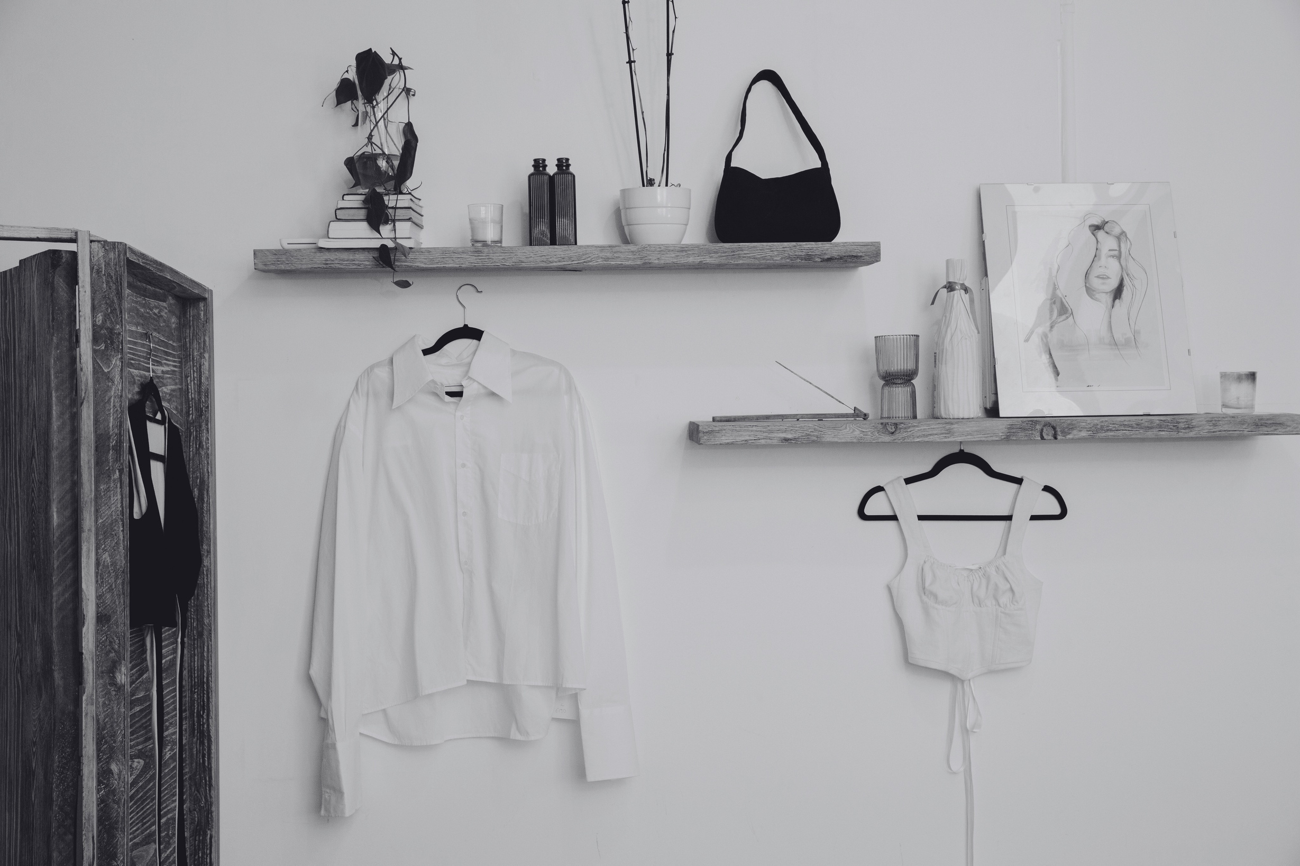
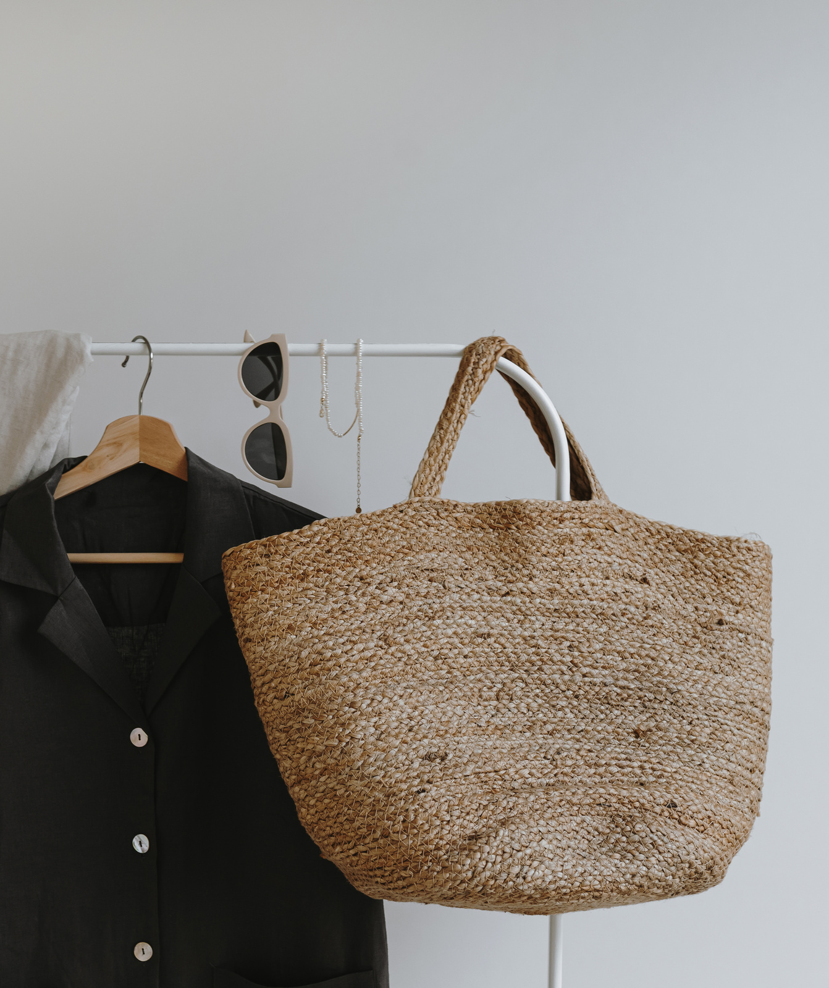
Informative graphics and carousel posts(authentic & informative content)
Content strategy
Interactive Campaigns
Customer Testimonials
Blogs
Paid Targeted Ads
Relationship Marketing
Collaboration with influencers
Source- AI generated image

Slide 29
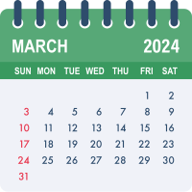
Content Pegs
13
14
15
17
18
20
21
22
23
24
25
EDUCATE
ENGAGE
INFLUENCE
27
28
-Blogs
-Carousel about ethical manufacturing
-Certifications
-Facebook Live(talking about the manufacturing process)
-Resharing GRWM videos of influencers
-#Yellow Day
-Polls on Instagram stories
-GoogleAds
-Client testimonials
#ReduceYourImpactStory- asking audience to share their story(Giveaway)

Slide 30
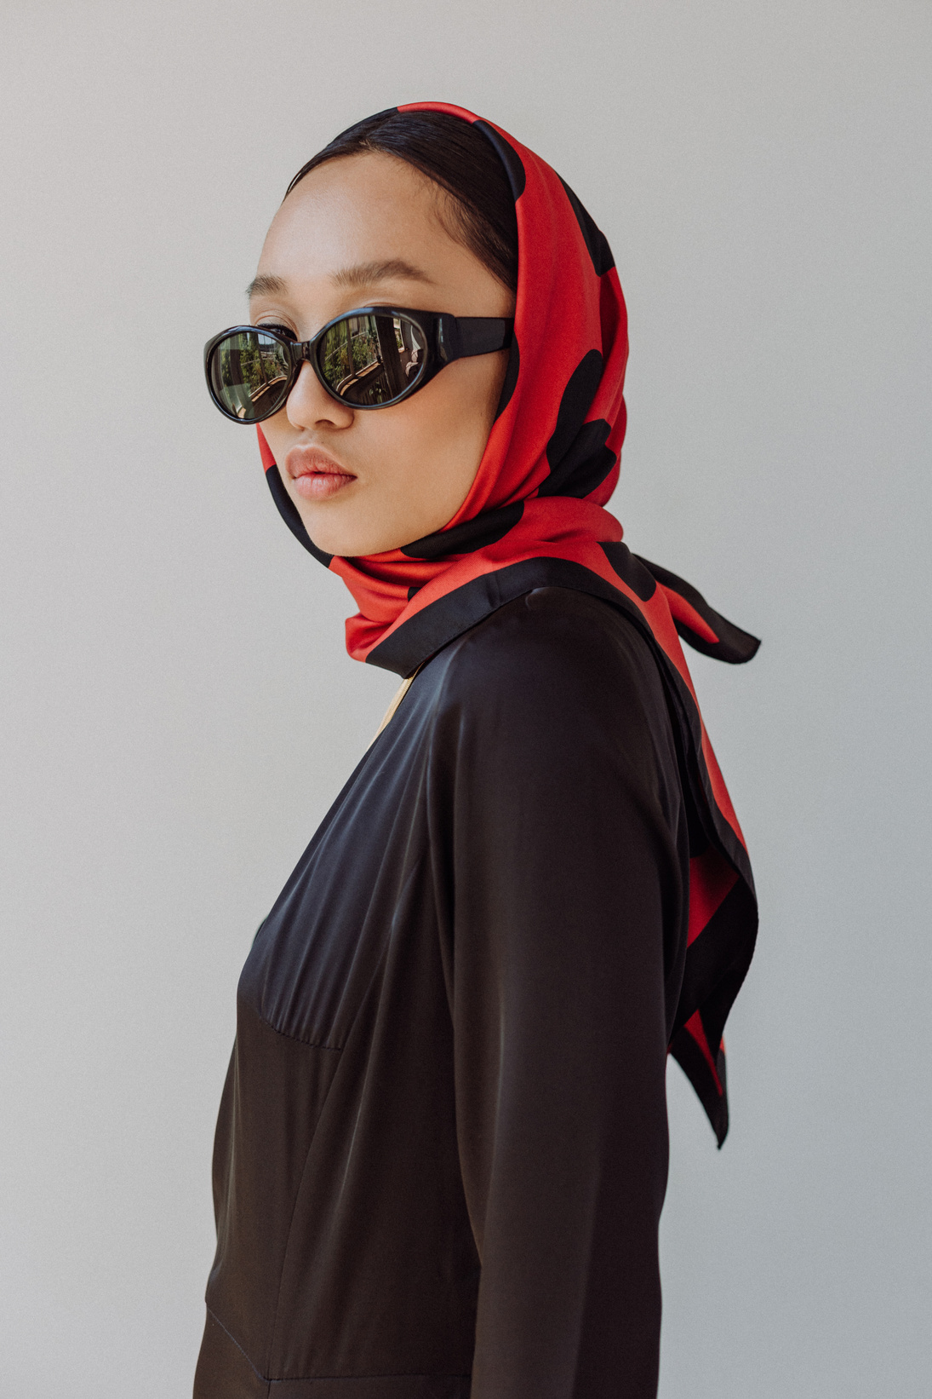

Best Practices
Promote Authentic &
Educational Content
Share visually stunning
images and videos
Collaborate with fashion and
sustainability influencers
Use hashtags like #sustainablefashion, #sustainablefashionbrand, and #bambooclothingforwomen that can help increase visibility
Source- AI generated image

Slide 31
Best Practices
Use Call To Action in very post
Use Keywords like bamboo lothing, bamboo clothing canada,bamboo wear Canada, bamboo clothing store
Best time to post between 9am to 6pm
(depending upon the platform)
Actively engage with
customers
Source- AI generated image, Semrush, Hubspot

Slide 32
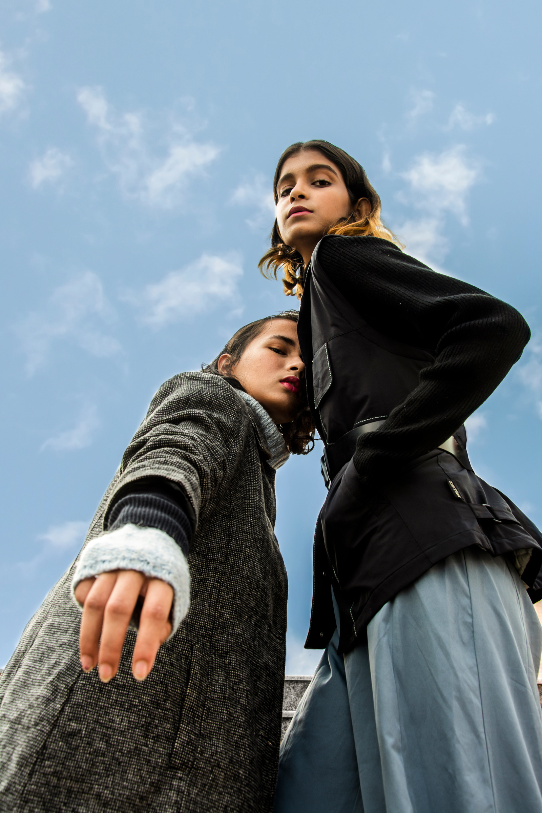



Tuning
Review performance and extend partnerships with top influencers.
Reassess collaborations with underperforming influencers.
Align strategy with business goals.
Regularly review metrics and adjust strategy as needed.
Source- AI generated image

Slide 33

Budgeting
Instagram/Facebook Ads
$100
Google Ads
$40
Influencer Barter Deals
$300
HubSpot Basic Plan
$20
Social Media Manager Salary
$960
TOTAL MONTHLY BUDGET ESTIMATE
$1260
Note: Revenue is assumed to be $45000/month
Arwen’s Apparel wants to spend around 4% of their revenue on marketing. So most of the marketing will be organic

Slide 34
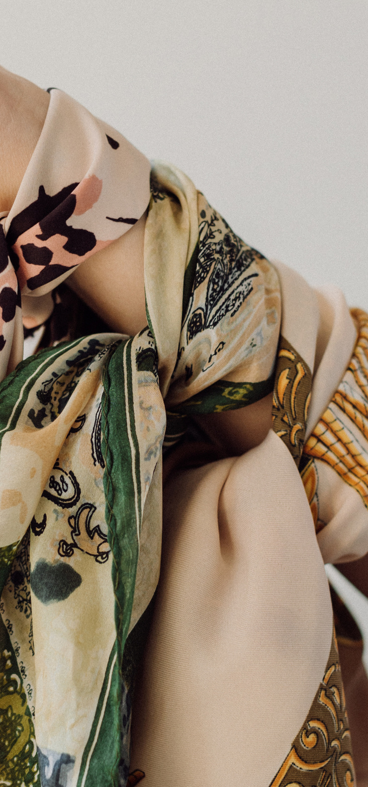
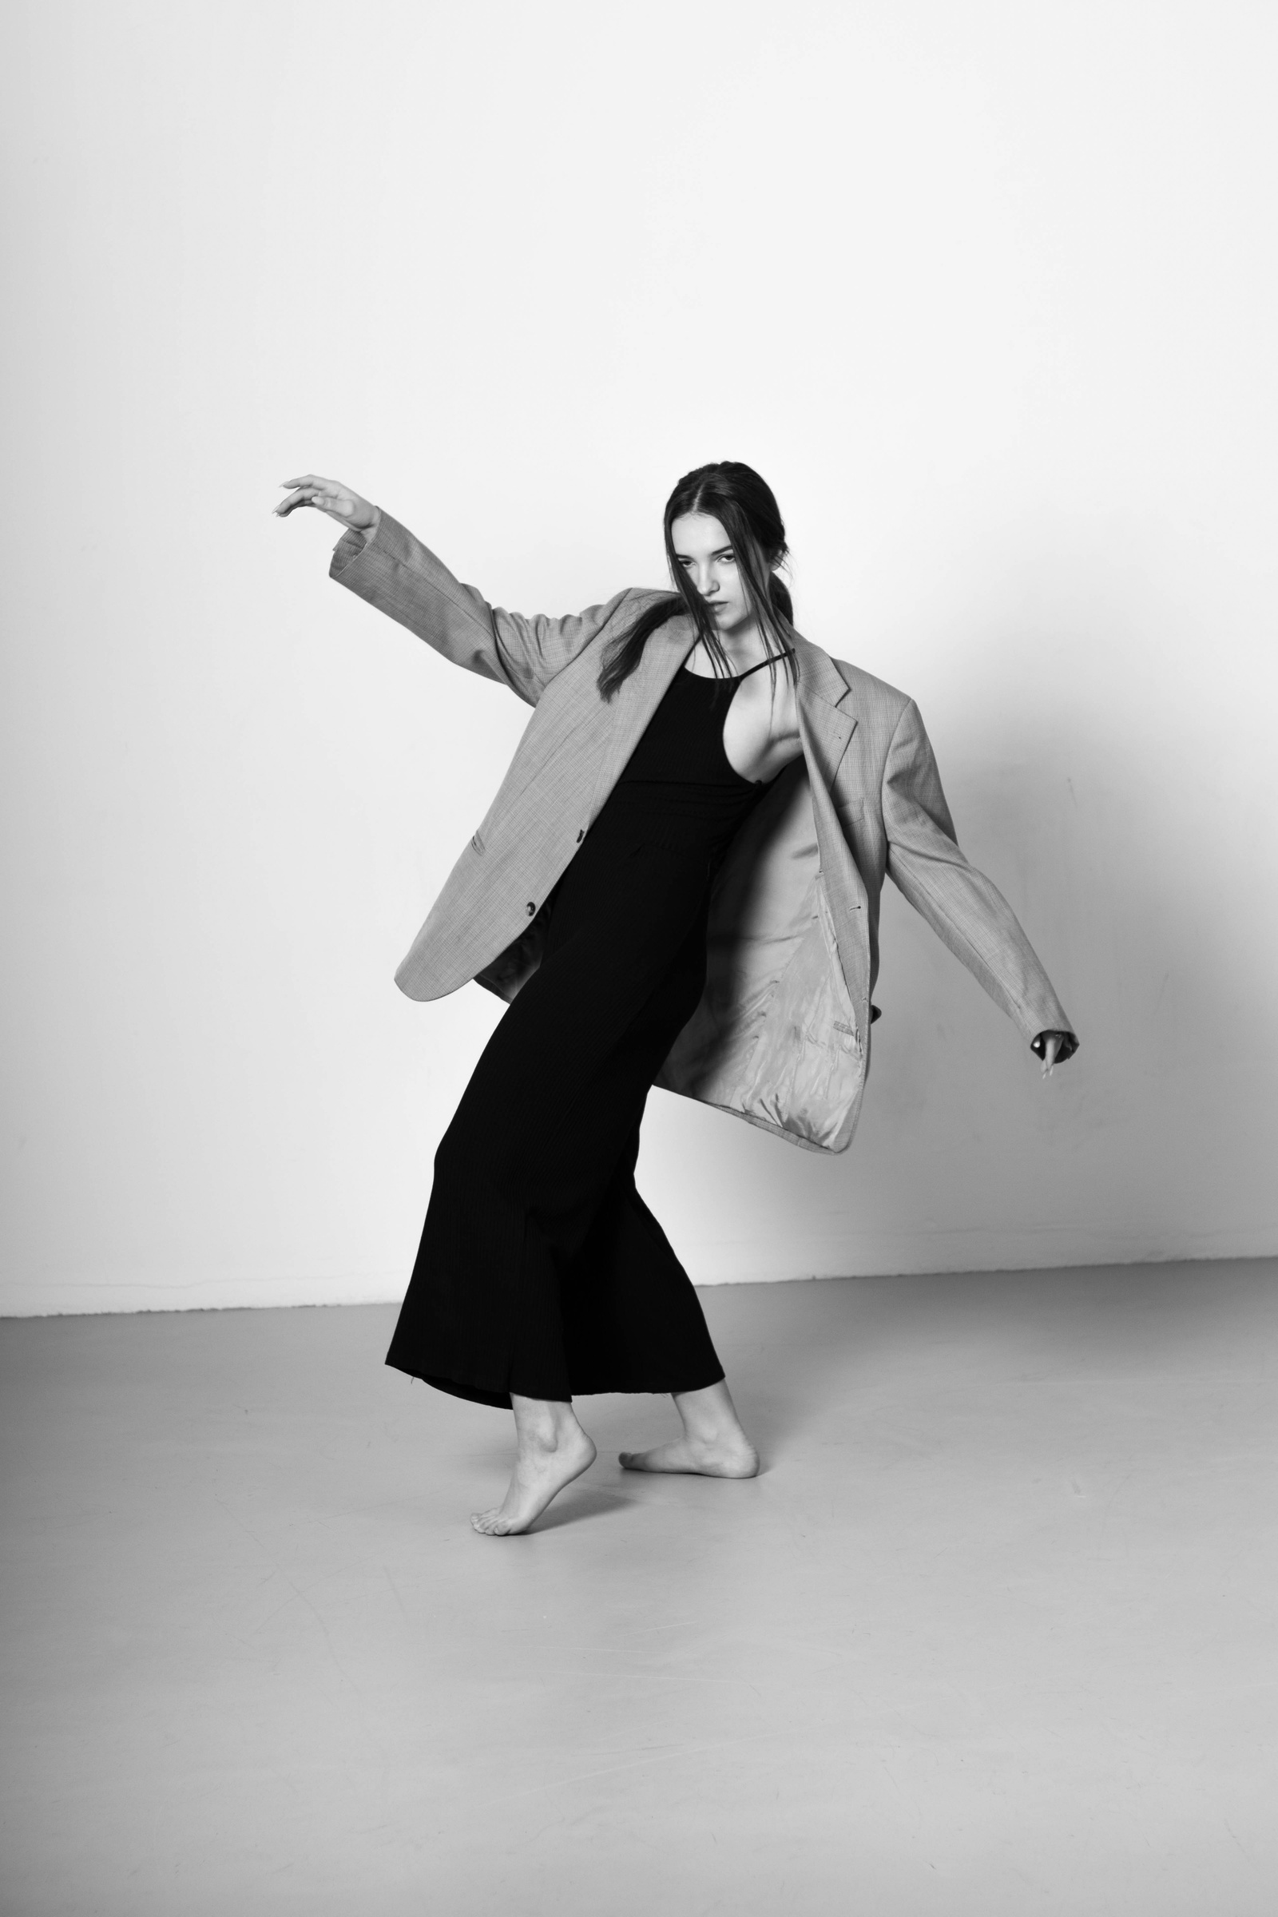
Conclusion
  Capitalizing on Social Media
  Prompt Website Launch
  Utilizing Pinterest
  Building Brand Awareness:
Source- AI generated image

Slide 35
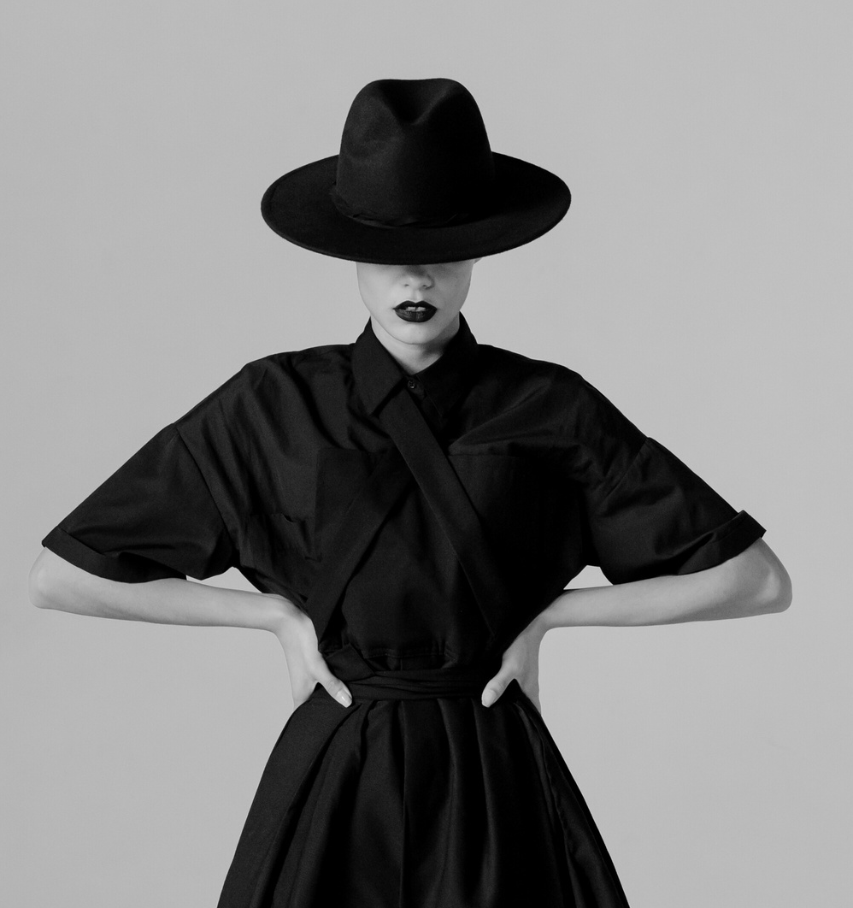
WELCOME
ABOUT US
OUR TEAM
MISSION & VISION
LOOKBOOK
CONTACT
PREPARED BY:
GLORI AMUKAMARA
JASBIR KAUR
KRITIKA LALWANI
ODINAKA OKAFOR
SATYA PAL SINGH
Thank you
Source- AI generated image

